Slide 1
Revocation of academic degrees based on real-life examples
27th October, 2020
Brno, Czech Republic

Slide 2
Purpose of this document: To show the real-life examples of people who had faced with the issue of revocation of their academic degrees by different universities in the world.
Responsible person: Nazrin Alizada yalizad1@mendelu.cz
Target Group: Everyone

Slide 3
Cases in United States

Slide 4
John Walsh – Senator in United States from 2014 to 2015
Institution: US Army War College
He received Master’s degree in 2007.
Thesis name: "The Case for Democracy as a Long Term National Strategy."
Reason: Plagiarism by taking words and ideas, without citations in the 14 pages of his master thesis.
Senator accepted the plagiarism allegations, however, he told that he had not done this on purpose.
Result: His master’s degree was revoked by university in 2014.
United States Senate http://www.senate.gov/senators/113th_Congress/graphics/walsh_john.jpg

Slide 5
Suvi Orr – PhD student
Institution: University of Texas
She earned her PhD in the chemistry field in 2008.
Reason: Existence of falsified data in her final work.
In 2014, Suvi Orr carried this issue to the court.
Court decision: University had violated rules.
Result: Orr won an injunction against University of Texas.
William Battle - University of Texas Visual Identity website https://brand.utexas.edu/identity/supporting-marks/

Slide 6
Case in Canada

Slide 7
John Measor - teacher
Institution: University of Calgary
He obtained his master degree in 2003.
Thesis name: “Canada and the Imposition of Sanctions on Iraq: 1990-2002.”
Reason: Plagiarism detected in his thesis after 15 years.
Result: In 2018, degree was revoked.

Slide 8
Cases in Germany

Slide 9
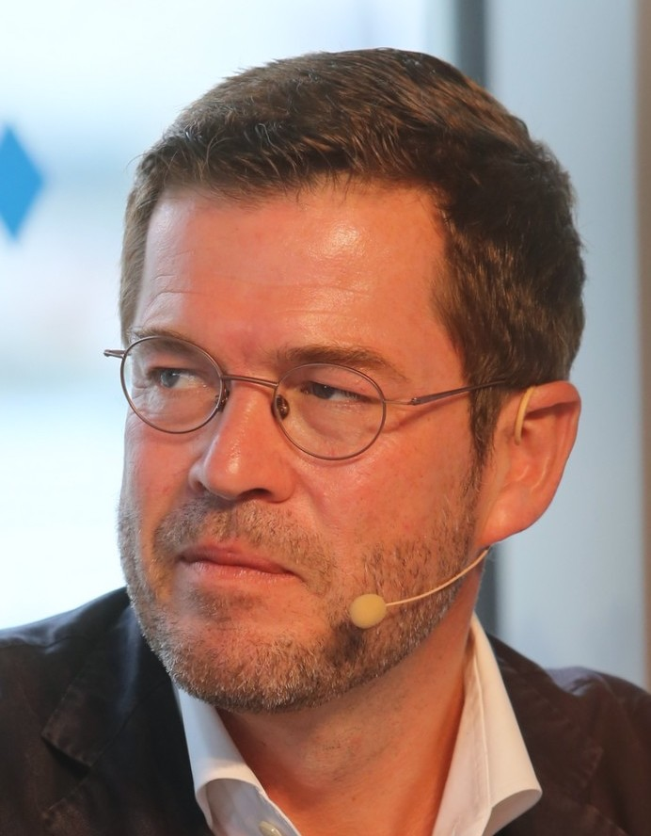
Karl Theodor zu Guttenberg- Defence Minister of Germany from 2009 to 2011
Institution: University of Bayreuth
He had PhD degree in law obtained in 2007.
Reason: Plagiarism in his dissertation.
Minister said that “I neither knowingly nor intentionally deceived”.
Result: Bayreuth University revoked Guttenberg's PhD in 2011.
Guttenberg resigned from all political posts in 2011.
Michael Lucan, Lizenz: CC-BY-SA 3.0 de

Slide 10
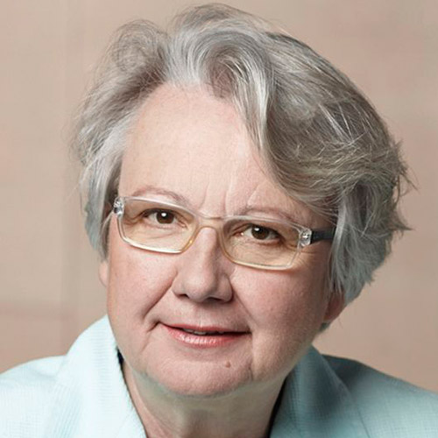
Annette Schavan- Education Minister of Germany from 2005 to 2013
Institution: University of Düsseldorf
She had obtained PhD degree in the year 1980.
Reason: Plagiarism without showing the more than 60 sources in her thesis.
Result: University revoked her doctoral degree in 2013.
She quits from her job in 2013.
Laurence Chaperon - Attribution-Share Alike 3.0 Germany

Slide 11
Case in Hungary

Slide 12
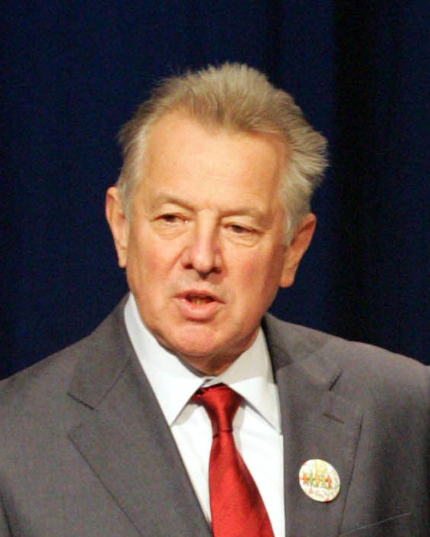
Pál Schmitt – President of Hungary from 2010 to 2012
Institution:Testnevelési Egyetem (University of Physical Education)
He received his PhD degree at in the year 1992.
Reason: Plagiarism in his doctoral thesis.
Result: University revoked his degree in 2012.
Schmitt resigned his post at the same year.
Európa Pont - Flickr.com CC BY 2.0

Slide 13
Case in Finland

Slide 14
Male foreign student
Institution: University of Eastern Finland
He received master’s degree in physics in 2011.
Reason: Plagiarism (serious and continual research fraud).
Student strongly denied the plagiarism allegations and appealed the university.
Court decision: Student’s degree was revoked in 2013, however, court decided that universities should find the mistakes at earlier stages of the research process.
CC BY-SA 4.0

Slide 15
Cases in Spain

Slide 16
Cristina Cifuentes - Regional leader of Madrid from 2015 to 2018
Institution: King Juan Carlos University
She received master’s degree in public law in 2012.
Reason: She had never legally completed the coursework of the university.
Result: Her master’s degree was revoked in 2018.
She denied these allegations and she did not resign from her political posts. However, in April 2018, shoplifting video of Cristina Cifuentes emerged in media, which had happened seven years ago. This is why she quited her posts in 2018.
Cristina Cifuentes - Flickr This file has been extracted from another file: Consejo de Gobierno de la Comunidad de Madrid, 17 de abril de 2018 (40825585204).jpg. CC BY 2.0

Slide 17
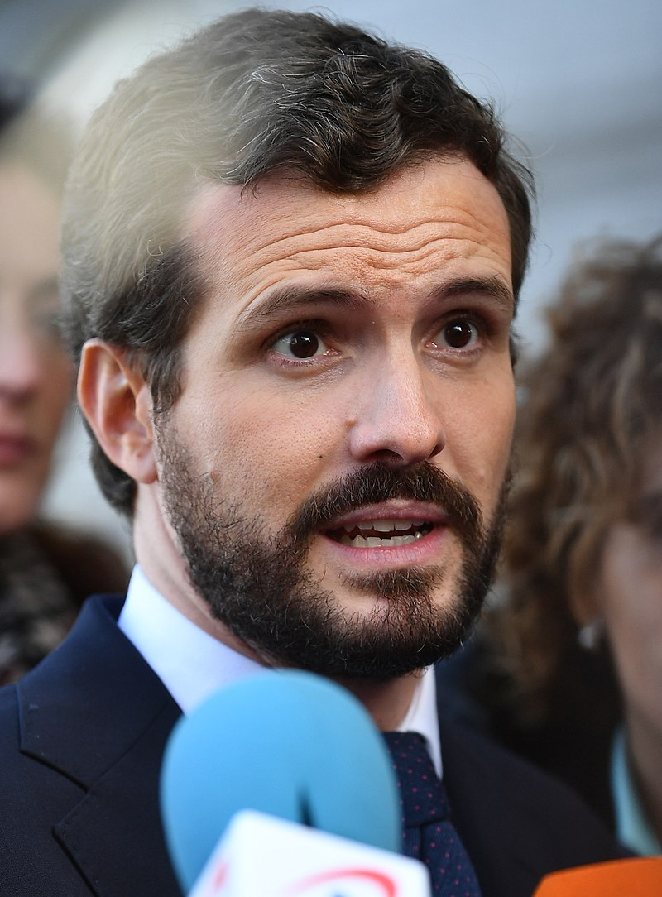
Pablo Casado – Spanish politician and current president of People’s Party (PP), 2020
Institution: King Juan Carlos University
He had obtained master’s degree in Regional and local law in 2009.
After Cristina Cifuentes, Casado had revealed that he is also graduate from the same university. Casado: “I was not required to attend class nor to take exams, that was what I was told at the beginning of the master, and that was my case”
After graduation of Casado in 2009, the university system had changed to the European Union’s Bologna Process.
After investigations in 2018, Casado could keep his academic degree.
European People's Party - EPP Summit, Brussels, 12 December 2019. CC BY 2.0

Slide 18
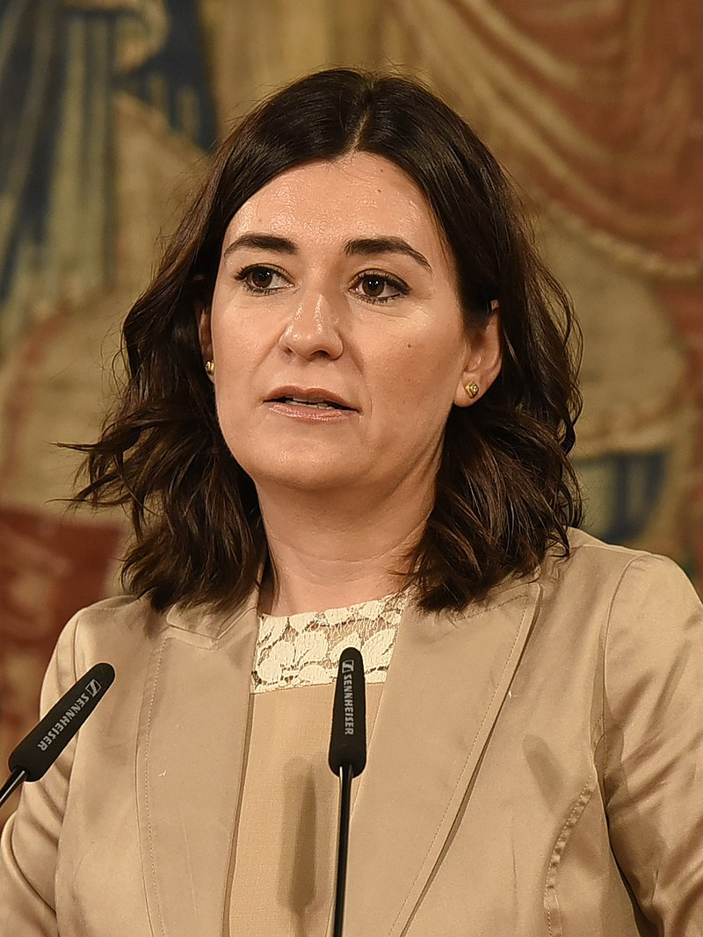
Carmen Monton – Minister of Health in Spain from June 2018 to September 2018
Institution: King Juan Carlos University
She received master’s degree in interdisciplinary gender studies in 2011.
Reason: Plagiarism from Wikipedia and other websites in her dissertation.
Carmen Monton had denied plagiarism allegations.
Result: She kept her degree, however she resigned from her job in September 2018.
Emiliano García-Page Sánchez from Toledo, España - Reunión con la ministra de Sanidad, Consumo y Bienestar Social. CC BY-SA 2.0

Slide 19
Case in Czech Republic

Slide 20
Female student
Institution: Palacký University Olomouc
Student obtained her master degree in 2015.
Reason: Cheating and academic fraud in final state exam by using ear buds.
Student sued the university.
Court decision (2019): She could keep her master’s degree.
Vera Maresova - http://vizual.upol.cz/logotypy.html CC BY-SA 4.0

Slide 21
Case in Slovakia

Slide 22
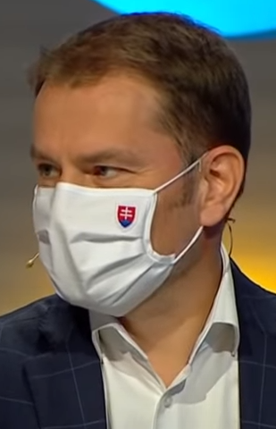
Igor Matovič – Current Prime Minister of Slovakia (2020)
Institution: Faculty of Management at Comenius University
He obtained his master degree in 1998.
Reason: Copying sentences without quotations.
Result: In Slovakia, there is no legislation in order to revoke degrees. This is why any further investigation was not implemented in this example.
In addition, Igor Matovič is not only politician in Slovakia, who had comitted plagiarism in final thesis.
Televízia JOJ - CC BY 3.0

Slide 23
Case in Romania

Slide 24
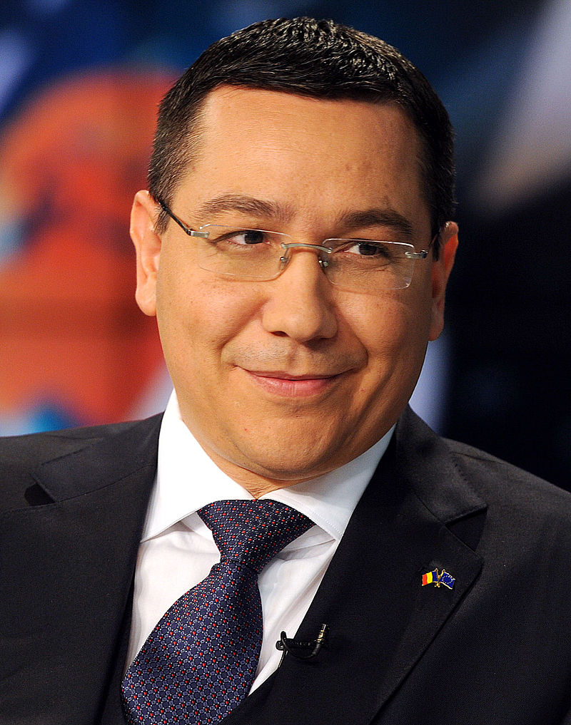
Victor Ponta – Prime Minister of Romania from 2012 to 2015
Institution: University of Bucharest
He obtained his PhD degree in 2003.
Reason: Plagiarism and absence of clear attribution of sources.
Ponta denied allegations of plagiarism and different committees were created in 2012 to investigate the process. They gave different decisions. Ponto appealed the court, but it was rejected.
Result: Ponta’s degree was revoked in 2014. However, he resigned in 2015 because of other reasons.
Ponta is not only politician in Romania, who had been accused of plagiarism. Corina Dumitrescu, Ioan Mang, Liviu Pop are also in this list. And they had resigned after allegations.
CC BY 2.0

Slide 25
Case in Albania

Slide 26
Evis Kushi- Current Minister of Education of Albania (2020)
Institution: Staffordshire University in UK.
She obtained her PhD in 2008.
Reason: 90 percent of final work had been plagiarized.
Result: Kushi denies these allegations and she still execute her duty.
In addition, Kushi is not only politician who is accused on plagiarism in Albania. There are seven other politicians had been under suspicion because of plagiarism. However, neither universities nor government had made any investigation about these allegations.

Slide 27
Case in Japan

Slide 28
Serkan Anilir – Turkish assistant professor in Japan
Institution: University of Tokyo
He received PhD of engineering in 2003.
Reason: Falsifying and lying about his academic career history on his resume.
Result: University revoked his doctorate in 2010 and ended assistant professor career at university.

Slide 29
Questions for discussion
What do you think about given real-life examples?
If you were be in the same situation, how would you react?
Is it general standard that after plagiarism is proven the plagiarist resign from his/her job?
Notes:
You can see some questions and answers about revocation of degrees from the article by Gary Pavela (2014) “Law and Policy in Higher Education”
https://medium.com/law-and-policy-in-higher-education/law-and-policy-in-higher-education-6be381f9be0a

Slide 30
Message of material
The message of given material is to explain the possible results of academic fraud in assignments, exams and final dissertations. Based on the real-life examples, we can conclude that any forms of academic dishonesty can cause serious consequences in professional careers
But what can be done to prevent this at first place?
From all these academic based revocation cases, we can see that the main reasons of revocation problems are the lack of reliable ethical culture and standards in education system. Students clearly should be informed about the importance of academic integrity when they are accepted to the university. And if committees of universities investigate plagiarism or cheating at first place before awarding degree, this can prevent majority of these cases. This is why law and policy of higher education institutions need to prepared by considering promotion of more ethical and disciplinary approach.
Notes:
You can also read the article by J. A. AUNIÓN (2013) “I will not copy, I will not copy...”
EL PAIS https://english.elpais.com/elpais/2013/09/23/inenglish/1379941258_033175.html

Slide 31
References
Lauren Barbato (2014) „This Senator Just Lost His College Degree“. Retrieved from https://www.bustle.com/articles/43835-sen-john-walsh-loses-army-war-college-degree-over-plagiarism-scandal
Alex Rogers (2014) „Montana Senator's Degree Revoked Over Plagiarism Charges“ Retrieved from https://time.com/3491095/john-walsh-plagiarism/
Alison McCook (2017) „Chemist wins injunction against university trying to revoke her degree“. Retrieved from https://retractionwatch.com/2017/04/21/chemist-wins-injunction-university-trying-revoke-degree/
Helen Pidd (2011) „German defence minister resigns in PhD plagiarism row“. Retrieved from Guardian https://www.theguardian.com/world/2011/mar/01/german-defence-minister-resigns-plagiarism
Ben Brumfield (2013) “German education minister loses PhD over plagiarized thesis”. Retrieved from https://edition.cnn.com/2013/02/06/world/europe/german-minister-plagiarism/index.html
BBC News (2013) „German minister Annette Schavan quits over plagiarism“. Retrieved from https://www.bbc.com/news/world-europe-21395102
ČT24 (2019) https://ct24.ceskatelevize.cz/regiony/2852324-studentka-mela-u-statnic-v-uchu-sluchatko-univerzita-ji-chtela-odebrat-titul-soud

Slide 32
References
Akky Akimoto (2013) „CV frauds revealed by diligent online fact checks“. Retrieved from https://www.japantimes.co.jp/life/2013/01/16/digital/cv-frauds-revealed-by-diligent-online-fact-checks/
Acatiimi https://www.acatiimi.fi/7_2016/14.php
Susana Urra (2018) ”Madrid premier returns controversial master’s degree, but blames university“. Retrieved from El Pais https://english.elpais.com/elpais/2018/04/17/inenglish/1523950657_212474.html
Urra and Hunter (2018) „Master’s degree scandal deepens, as another PP politician admits not going to class“. Retrieved from El Pais https://english.elpais.com/elpais/2018/04/10/inenglish/1523345735_964396.html
Sam Jones (2018) “Spain's health minister quits over degree scandal”. Retrieved from El Pais https://www.theguardian.com/world/2018/sep/12/spain-health-minister-carmen-monton-resigns-masters-degree-irregularities
Palko Karasz (2012), “Hungarian President Resigns Amid Plagiarism Scandal”. Retrieved from https://www.nytimes.com/2012/04/03/world/europe/hungarian-president-pal-schmitt-resigns-amid-plagiarism-scandal.html

Slide 33
References
Julius Kravjar (2020) “Recent High Politicians’ Plagiarism Cases in Slovakia” Retrieved from ENAI Newsletter https://mailchi.mp/42300684070e/enai-august2020?e=7007dc92d8#mctoc1
DPA International (2020) “Slovakian Prime Minister Matovic latest to be accused of plagiarism” https://www.dpa-international.com/topic/slovakian-prime-minister-matovic-latest-accused-plagiarism-urn:newsml:dpa.com:20090101:200716-99-821241
Jonathan Bailey (2020) “The Ongoing Albanian Plagiarism Crisis” Retrieved from https://www.plagiarismtoday.com/2020/09/30/the-ongoing-albanian-plagiarism-crisis/
Tirana Times (2020) “Minister of Education accused of plagiarism” Retrieved from https://www.tiranatimes.com/?p=147294
Jonathan Bailey (2012), “The Plagiarism Insanity in Romania” Retrieved from Plagiarism Today https://www.plagiarismtoday.com/2012/07/02/the-plagiarism-insanity-in-romania/
Irina Popescu (2016) “Former PM Victor Ponta may be disbarred after losing doctor degree”. Retrieved from Romania-Insider.com https://www.romania-insider.com/former-pm-victor-ponta-might-excluded-bucharest-bar
Bill Graveland (2018) “University of Calgary can rescind master’s degree over plagiarism: judge” Retrieved from https://globalnews.ca/news/4467017/university-of-calgary-judge-masters-degree-plagiarism/
Jonathan Bailey (2018) “Revoking Degrees: How and Why Schools Do It?” Retrieved from Plagiarism Today https://www.plagiarismtoday.com/2018/09/27/revoking-degrees-how-and-why-schools-do-it/
Jonathan Bailey (2012), “The Plagiarism Insanity in Romania” Retrieved from Plagiarism Today https://www.plagiarismtoday.com/2012/07/02/the-plagiarism-insanity-in-romania/
Irina Popescu (2016) “Former PM Victor Ponta may be disbarred after losing doctor degree”. Retrieved from Romania-Insider.com https://www.romania-insider.com/former-pm-victor-ponta-might-excluded-bucharest-bar

