Slide 1
Bridging academic integrity and research integrity in a game on falsification
John
Monica
Slavica
Colleagues
Developed by Sonata Vyšniauskienė, picture credits: Sandra Krutulienė

Slide 2
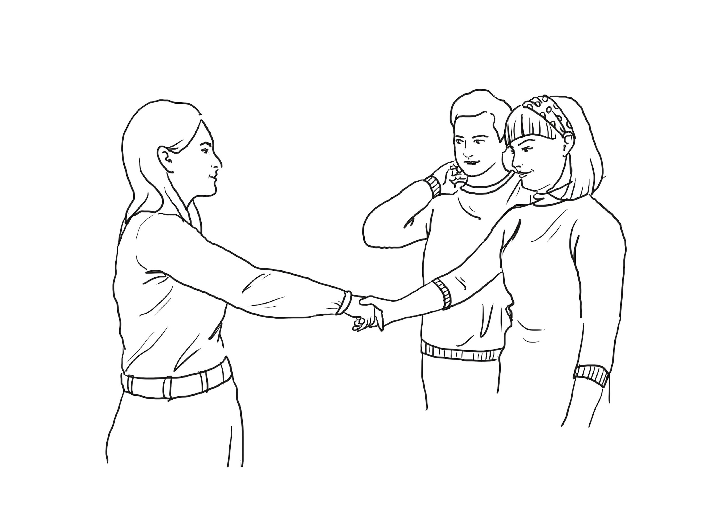
The research company "Delta" announced a public procurement for research services. John and Monica, researchers from the institute "Science“, applied for this procurement and received funding. During the first meeting with Slavica, the head of the Delta project department, they discussed research aims, objectives, target groups, methods, and other relevant aspects.

Slide 3
John and Monica start the research. After gathering all the necessary information, they submit the final report. A few weeks after the submission, John and Monica received an invitation to meet with Slavica. According to Slavica, the research findings presented in the report do not meet company expectations.
We think that the research had to be done differently.
Why?
What do you mean?
It would be better not to present some research findings in the report because they do not match the company’s expectations. As we are financing the research, we expect you to move the research results in the right direction.

Slide 4
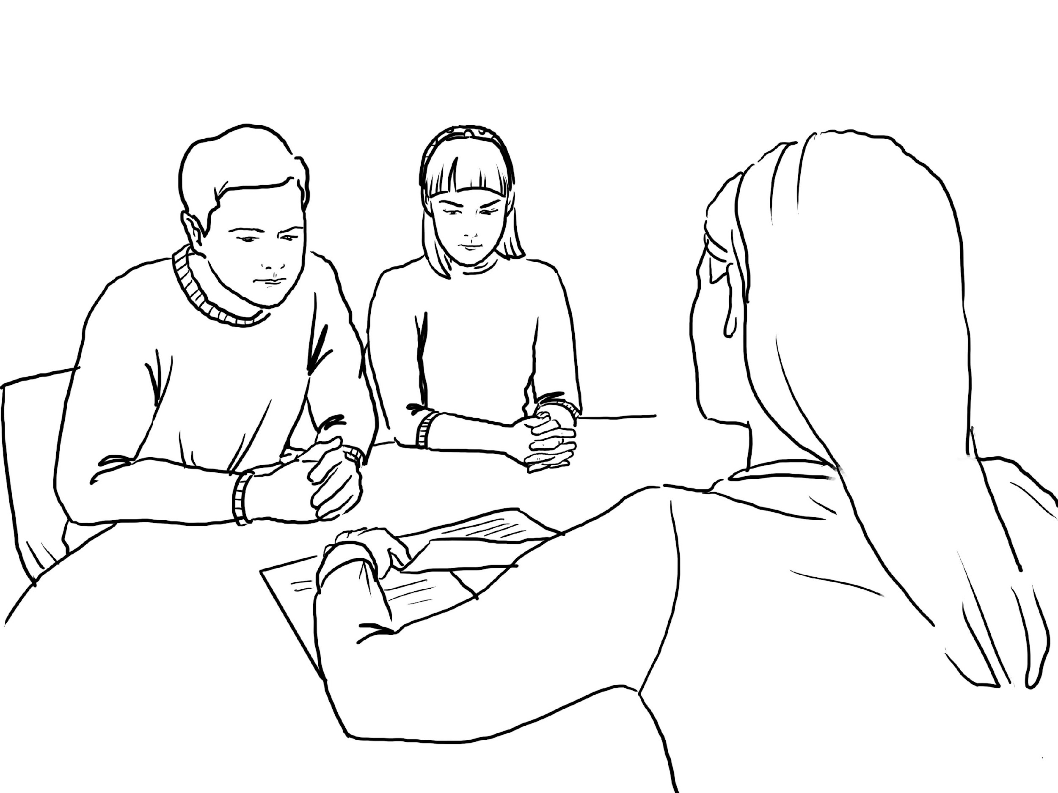
After the meeting, John and Monica received a significantly revised version of the report from Slavica.
Here, let me help you with the research report. I’ve added important changes so it works better now. We will now make this version public, I just need your signatures.

Slide 5
John and Monica ask for some time to review the new version of the report. After reviewing the updated version in detail, they notice that significant parts of the research data, text, and conclusions have been changed, forged, or falsified.
In some tables, the significance level is changed!
They added additional conclusions not supported by the research findings!
What should John and Monica do in this situation?
A) Talk with the Delta manager about the findings
B) Agree to the changes and proceed with the payment for the project
C) Decline the falsified data and refuse to sign the modified report
Some of the data are completely falsified!

Slide 6
John and Monica meet with Slavica.
We could accept corrections if they were consistent with the research findings, but these changes are fictional, based on falsified data.
The version of the report that you want us to sign has been significantly modified.
?!!?
We cannot sign and meet the terms of the contract given such a report.

Slide 7
We think that inappropriate research methodology and data analysis methods were chosen in your research.
Delta has data from its previous research and we think that our data are more suitable.
What?!?
Let’s avoid debate and continue to work together.
If you want to terminate the contract, we will not be able to pay you as you have not fulfilled the terms of the agreement.
What should John and Monica do in this situation?
A) Withdraw from the project and confirm failure due to the data quality disagreement
B) Withdraw their collected survey data and the report without consent to further use of the data
C) Accept Slavica's offer and get paid for the project

Slide 8
John and Monica agreed to the changes made by the company. They sign their names on the report and say a friendly goodbye to Slavica.

Slide 9
A few weeks later, John and Monica receive an invitation from their colleagues to collaborate and submit a joint project proposal. John and Monica agree to cooperate.
However, a few days later, they receive a call from their colleagues inviting them to meet face to face.

Slide 10
John and Monica meet their colleagues.
Unfortunately, we cannot continue to cooperate with you and include you in our project team.
It is kind of embarrassing to talk about it, but there are rumours among the researchers about you, that you conduct your research in a "sloppy" manner, and in most cases do not conduct the research at all and falsify the data.
So, let’s discuss what we need to do next.
What should John and Monica do in this situation?
A) Try to justify themselves, saying that the research company Delta forced them to sign the falsified report and that they have now severed all ties with Delta
B) Quietly withdraw from preparing the project application
C) Decide to make this story public

Slide 11
John and Monica decide to decline the falsificated data.
They meet with Slavica again.
We cannot accept these changes in the report. Of course, we can make some corrections in the report that are consistent with the research findings.
I need to discuss this situation with my colleagues. I will be in touch by email shortly for a final decision.

Slide 12
After a week, John and Monica receive an e-mail from Slavica.
E-mail:
Dear John and Monica,
I would like to inform you that Delta has rejected your research report. We regret that you were not able to investigate the research problem properly and take into account the complexity of the research data. We have decided to terminate the contract and cancel your payment. In addition, our accountant will send you an invoice as we need compensation for the inconvenience.
Best regards,
Slavica
What should John and Monica do in this situation?
A) Apply to the research ethics authority regarding data falsification and refusal to pay for the work
B) Pay the compensation required and terminate any relationship with the Delta research company
C) Request a meeting with Slavica

Slide 13
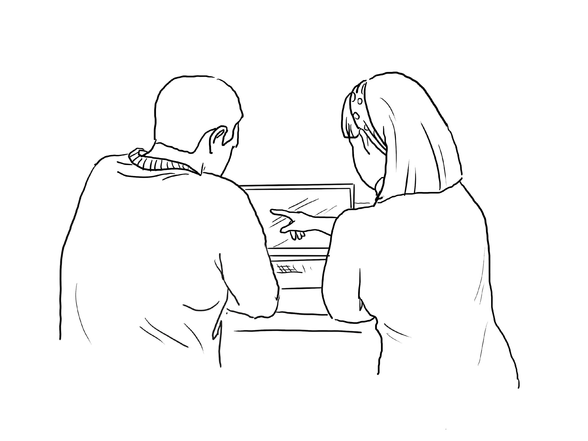
John and Monica withdraw from the project and confirm termination due to data quality disagreement.
We refuse the payment and agree with the termination of the project, because of the data quality disagreement.

Slide 14
A few months later, the researchers are surprised to see a published article containing their collected data mixed with falsified data. The article is presented in a prestigious journal.
What is this? We agreed not to use that data?!
What?!
What should John and Monica do in this situation?
A) Ignore the detected article and continue with their work
B) Write to the editors, informing them of the falsified data
C) Contact Delta’s manager about the article and falsified data

Slide 15
John and Monica withdraw their data and research report without consenting to further use by the research company Delta. They sign a written agreement not to use the data they collected.
A few weeks later, John and Monica receive a letter from the Research Ethics Commission. Someone from Delta filed a complaint about the research conducted by John and Monica and about the report using falsified data.
Can you believe this?
What?!
What should John and Monica do in this situation?
A) Contact the Delta manager demanding that their names be withdrawn from the complaint
B) Submit a complaint to the Research Ethics Commission regarding the falsification of data by Delta
C) Contact the Research Ethics Commission demanding that their names be withdrawn from the complaint and sending the original research report to them as evidence

Slide 16
John and Monica agreed to the changes made by the company. They sign their names on the report and say a friendly goodbye to Slavica.

Slide 17
A few weeks later, John and Monica receive an invitation from their colleagues to collaborate and submit a joint project proposal. John and Monica agree to cooperate.
However, a few days later, they receive a call from their colleagues inviting them to meet face to face.

Slide 18
John and Monica meet their colleagues.
Unfortunately, we cannot continue to cooperate with you and include you in our project team.
It is kind of embarrassing to talk about it, but there are rumours among the researchers about you, that you conduct your research in a "sloppy" manner, and in most cases do not conduct the research at all and falsify the data.
So, let’s discuss what we need to do next.
What should John and Monica do in this situation?
A) Try to justify themselves, saying that the research company Delta forced them to sign the falsified report and that they have now severed all ties with Delta
B) Quietly withdraw from preparing the project application
C) Decide to make this story public

Slide 19
John and Monica tell their side of the story.
You must file a complaint with the Research Ethics Commission.
You must make your story public!
Hmmm!?
What should John and Monica do in this situation?
A) File a complaint with the Research Ethics Commission about the data falsified by the research company Delta
B) Try to convince their colleagues that there is no need to file a complaint because John and Monica put their names on the report and received payment
C) Leave the current situation and try convincing their colleagues to forget the rumours and continue working together

Slide 20
John and Monica decide to quietly withdraw from participation in preparing the project application.
We signed our names to that report and this could get us in trouble.
I think it is better if we do not tell our colleagues about the data.

Slide 21
After a while, they notice that their colleagues have started to avoid them. Their colleagues no longer offer to collaborate on articles or project applications.
We are planning to prepare a project application, maybe you would like to collaborate?
We don’t know how to say this, but there is a rumour going around about the quality of your work.
What should John and Monica do in this situation?
A) Make their story public in the workplace
B) Invite colleagues to investigate the research company Delta’s work and get their story in the media
C) Convince their colleagues that there is nothing worrisome about the false rumours
Thank you for this proposal. But not this time.

Slide 22
John and Monica decide to tell their story publicly to a local university newspaper.
We have to do this, there is no other way!
Okay!

Slide 23
After seeing the article in the newspaper, the research company Delta submits a claim to the Research Ethics Commission.
After its investigation, the Research Ethics Commission send John and Monica a letter stating that John and Monica had falsified data when creating a research report for Delta.
Can you believe this?!
Wow?!
What should John and Monica do in this situation?
A) Retract the article from the local newspaper and continue with their work
B) Try to find more evidence that the research company Delta falsified data
C) Officially deny the conclusions of the Commission and try to prove that the report bearing their signatures is correct and does not contain falsified data

Slide 24
John and Monica decide to apply to the Research Ethics Commission regarding the data falsification and the refusal to pay for the work that was done.

Slide 25
After a few weeks, they receive a letter from the research company’s lawyer informing them that Delta is suing John and Monica for false accusations.
Can you believe this?
What should we do?
What should John and Monica do in this situation?
A) File a complaint with the Research Ethics Commission about the data falsified by the research company Delta
B) Ask to meet with the director of Delta
C) Agree to meet with Delta in court

Slide 26
After discussions, John and Monica pay the compensation required and terminate any relationship with the research company Delta.
After a while, John and Monica find the report bearing other researchers’ names publicly available on the Delta website.
What should John and Monica do in this situation?
A) Ignore what they found and do nothing
B) File a complaint with the Research Ethics Commission about the data falsified by the research company Delta
C) Contact the authors listed on the report and explain to them about the data falsified by the research company Delta

Slide 27
That e-mail was final. Our company is planning to sue you for not fulfilling the project agreement
John and Monica request a meeting with Slavica.
What should we do? We must resolve this situation!
We should receive payment for the decent work that we did!
What should John and Monica do in this situation?
A) Decide not to argue and agree to the terms of the research company Delta
B) Ask to meet with the director of Delta
C) File a complaint with the Research Ethics Commission about the data falsified by Delta

Slide 28
John and Monica decide to ignore the article they discovered, continue to do their jobs, and not get involved seeking justice. After a few months of intense work on another project, the researchers run into a problem. One of their colleagues has cited the falsified article.
What should we do?
I think we have to tell him.
What should John and Monica do in this situation?
A) Inform their new colleague that this article cannot be cited because it contains falsified data
B) Do nothing, and hope that citing this article with falsified data in the research report of the new project will not harm the project report in any way
C) Tell your colleague about your experience working for the research company Delta

Slide 29
Concluding narrative
Being in an ethical dilemma is always hard. Making the right decision or being proactive when encountering potential misconduct requires courage.
Falsification is a breach of research ethics. Therefore, it is important to recognise it as misconduct and deal with it.
If you suspect falsification, you should take responsibility for your further actions, even if they are difficult or may bring unpleasant feelings. Ignoring it or proceeding with the work is not in line with the principles of responsible research conduct. You can always start by consulting a responsible person.
Please, examine in more detail the suggested material explaining falsification, the consequences of misconduct, and what could be done when it is encountered.

Slide 30
Feedback
Discuss these questions with your students/participants:
Why do you think such data falsification occurs in real-life situations, such as cooperating with business entities?
How do you think it is necessary to act in such a situation, regarding data safety and the agreement with the company? What would be the best/fairest way to react in this situation?
What kind of complaint would you write to the Research Integrity Officer? Provide examples illustrating what type of complaint that would be. Form pairs in class and write an example of such a complaint.

Slide 31
Useful resources to learn more about how to deal with situations of misconduct
General guidelines for academic integrity: https://www.academicintegrity.eu/wp/guidelines/
Ethical conduct in research and practice (workshop): https://www.academicintegrity.eu/wp/materials/ethical-conduct-in-research-and-practice/
Responsible/irresponsible research practices: p-kacking, HARKing, preregistration, RCR, QRP, etc. – are you familiar with them? https://www.linkedin.com/pulse/p-hacking-harking-preregistration-rcr-qrp-terms-related-kravjar/
The lab: Avoiding research misconduct (interactive video): https://ori.hhs.gov/TheLab/

Slide 32
THANK YOU
http://www.academicintegrity.eu/wp/bridge/ https://twitter.com/projectbridge_ https://www.facebook.com/infobridgeproject
bridgeinfo@academicintegrity.eu

