Slide 1
Role play on FFP (Fabrication Falsification Plagiarism)
Learning objectives
The aim of this game is to provide students/participants with an opportunity to reflect on issues related to research data, data records, supervision, and participation of citizen scientists in research projects. The goal of the game is to teach master’s and PhD students to recognize unethical behaviour, understand it, and be informed about the ways they can avoid it.
By the end of this role play, students/participants should:
Be able to provide solutions for how to solve disputes concerning data.
Be able to recognize the appropriate grounds for data reliability, fabrication, falsification, and plagiarism in research.
Be able to recognize the importance of defining the various roles of those involved in research misconduct in advance in order to avoid potential disputes and disagreements.
Developed by Hajrulla Hajrullai and Veli Kreci

Slide 2
Role play on FFP (Fabrication Falsification Plagiarism)
Targeted audience
Master students, PhD students, and their supervisors.
Game Design/Instructions
This is a role-playing game where each of the participants takes one role.
Number of participants: 5
Estimated time: 1h
Read your role and prepare yourself for the meeting by reading the recommendations from The Fundamental Values of Academic Integrity and
The principles from The European Code of Conduct for Research Integrity (15 min)
Role-play (25 min)
Follow-up discussion (20 min)
Developed by Hajrulla Hajrullai and Veli Kreci

Slide 3
Role play on FFP (Fabrication Falsification Plagiarism)
Synopsis
The scene takes place at a university where the supervisor has noticed inconsistencies in the data reporting by the citizen scientists and by the PhD student in his/her thesis. The supervisor has addressed his/her concern in an informal discussion with the student, however, the student has decided to ignore these concerns and continue with the data analysis of his thesis.
The supervisor has decided to address this issue with all relevant parties within the institution. This is a meeting between all the concerned parties.
Developed by Hajrulla Hajrullai and Veli Kreci

Slide 4
Role play on FFP (Fabrication Falsification Plagiarism)
PhD student
Supervisor
Citizen scientist
Student advisor
Members of the disciplinary committee (more than 1)
Developed by Hajrulla Hajrullai and Veli Kreci

Slide 5
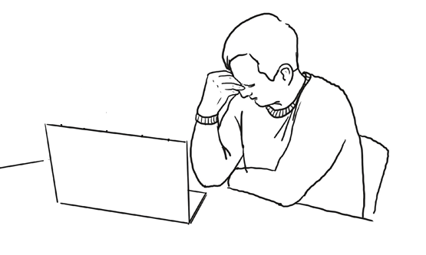
Role 1. A PhD student
You are a PhD student. You are facing immense pressure to complete your degree because your job depends on it. Instead of waiting for the final data from the needed measurements from the citizen scientists, you have taken the liberty to fill in the missing data assuming that your reports will follow the same pattern. Unaware of the consequences, you have ignored the concerns raised by the mentor and you find yourself at the meeting with all the concerned parties.
Think of justifications you can present to the supervisor, citizen scientist, member of the disciplinary board, and the student advisor who is taking minutes of the meeting.
What will you say to defend your position?
Developed by Hajrulla Hajrullai and Veli Kreci

Slide 6
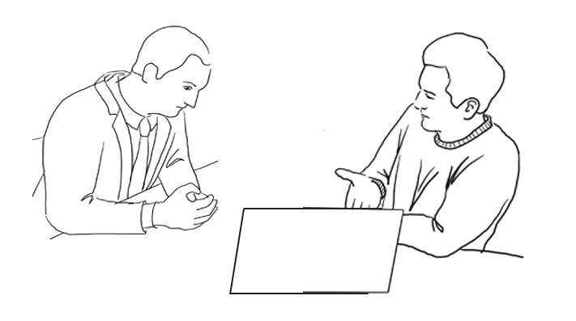
Role 2 Supervisor
You are the supervisor of the PhD student who has ignored your concern over the validity and reliability of the data. You have reported the case and you are called for a meeting. Make a list of reasons why you have reported this particular case.
Hint: read the guidelines on AI, ethics, data reliability, and quality of the thesis.
Developed by Hajrulla Hajrullai and Veli Kreci

Slide 7
Role 3 Citizen Scientist
Your role in this meeting is to express your concern about the validity of the data provided in the Phd thesis of the respected student. Your position is firm, the necessary measurements/data that the student claims he/she owns was never provided as such from your side which jeopardizes the whole project. Think of things you are going to say to all the members at this meeting.
Hint, expressing dissatisfaction with the reported results by the student and refusing to be involved in any way in his thesis. Be creative and add a variety of reasons why you would be dissatisfied with the results.
Just no.
Developed by Hajrulla Hajrullai and Veli Kreci

Slide 8
Role 4. Members of the disciplinary committee. (more than 1 person)
You are members of the disciplinary committee who need to identify the level of the disciplinary measures that need to be applied in this case of fabrication of data from citizen science projects. You are not aware of all the details of the dishonesty and you are present at the meeting to find out more about it. You have the Phd student, the supervisor, and the citizen scientist who is involved in the Phd thesis to answer all your questions.
Think of questions that you will ask the student and the supervisor in order to determine the level of dishonesty. Example: In terms of the data provided by the CSs, ask about the time, place, individuals who provided the data, and how the data was used and reported/handled by the student.
Once all the information is obtained, the members of the disciplinary committee will need to identify the disciplinary measures starting from
Minor
Moderate
Serious
The members of the committee need to vote on having to inform the student advisor of their decision about the disciplinary measures.
Members of the disciplinary committee (more than 1)
Developed by Hajrulla Hajrullai and Veli Kreci

Slide 9
Role 5 Student advisor
You, as a student advisor, take notes of the conversation and write down the key points of the meeting. You use these notes to draft an official email that describes all the key points addressed by all parties. In addition, you draft the email with the final decision reached by the members of the disciplinary committee. Please read aloud the email sent by you to the student where you report back to all parties the key points/events/decisions as well as the final decision of the committee.
Student advisor
Developed by Hajrulla Hajrullai and Veli Kreci

Slide 10
TIME TO ACT!
The meeting may start and everybody is in their roles.
Possible scenario of the role play
Step 1. The supervisor starts the meeting and explains why they called the meeting
Step 2. The student defends himself
Step 3. The citizen scientist denies participation
Step 4. Members of the disciplinary committee decide on the level of the measures
Step 5. Student advisor takes notes and reads out the final decision of the
Developed by Hajrulla Hajrullai and Veli Kreci

Slide 11
Concluding narrative
Being in an ethical dilemma isn’t always easy. We face these dilemmas in our everyday life. However, one should keep in mind that admitting that you have committed misconduct presents an important step in identifying and solving the problem.
Falsification, Fabrication, and Plagiarism breach the values of AI. As a result, it is important to acknowledge it as misconduct and take responsibility for it. Committing or engaging in either, falsification, fabrication, or plagiarism, one should take responsibility for their actions, even in cases when they are difficult to accept.
Denying, ignoring, and neglecting the accusations from relevant faculty members directly violates the fundamental values of academic integrity and research ethics.
Misconduct can be revealed at any stage of your professional life and can backfire harming your professional and personal credibility.
Developed by Hajrulla Hajrullai and Veli Kreci

Slide 12
Possible feedback
Discuss these questions with your students/participants:
What is the main cause for the falsification, fabrication and plagiarism among students?
Once FFP is detected, how do you think it is necessary to act in such a situation?
What else would you add to the role play? Are there any other issues which could be discussed from your personal opinion, on the ways similar situation can be mitigated?
Developed by Hajrulla Hajrullai and Veli Kreci

Slide 13
Useful resources to learn more about how to deal with situations of falsification, fabrication, plagiarism.
General guidelines for academic integrity:
https://www.academicintegrity.eu/wp/guidelines/
The European Code of Conduct for Research Integrity
https://www.allea.org/wp-content/uploads/2017/05/ALLEA-European-Code-of-Conduct-for-Research-Integrity-2017.pdf
Guidelines for Research Ethics and Research Integrity in Citizen Science
Guidelines for Research Ethics and Research Integrity in Citizen Science
Developed by Hajrulla Hajrullai and Veli Kreci

Slide 14
THANK YOU
http://www.academicintegrity.eu/wp/bridge/ https://twitter.com/projectbridge_ https://www.facebook.com/infobridgeproject
bridgeinfo@academicintegrity.eu
Developed by Hajrulla Hajrullai and Veli Kreci

