Slide 1
MODULE FOR SUPERVISORS
Session 2: How to help your students write and publish with academic and research integrity (checklists)
Created by Sandra Krutulienė (Lithuanian Centre for Social Sciences)

Slide 2
Module for supervisors Training plan/schedule by session
Session 1:
Ethical challenges related to supervision and mentorship in academia
Session 2:
How to help your students write and publish with academic and research integrity (checklists)
Session 3:
Helping students recognize and avoid breaches of academic and research integrity
Session 4:
Supervisor's role in guiding students engaged in citizen science and business-related projects

Slide 3
How to help your students write and publish with academic and research integrity
The importance of being prepared as a supervisor The importance of having a conversation with the student about academic and research integrity Supervisor’s responsibility in the process of thesis preparation, formulating research questions and study design, and data processing and analysis Supervisor’s role in guiding students through academic writing and ethical publishing The importance of communication and feedback

Slide 4
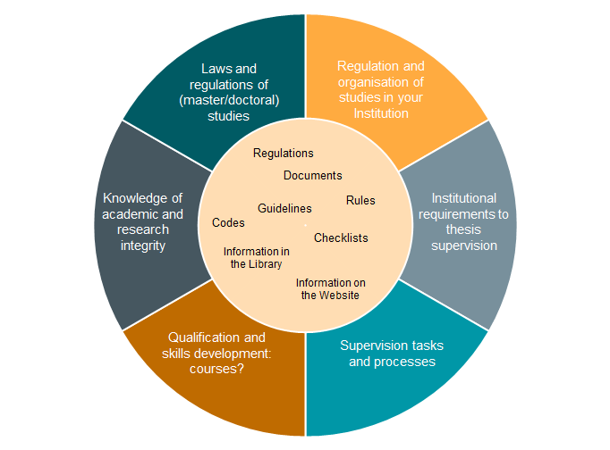
How to get ready?
What are my responsibilities?
What’s my role?
This Photo by Unknown Author is licensed under CC BY

Slide 5
I have read the institutional requirements relevant to thesis supervision and, if applicable, have taken the required courses in supervision.
I know where to find information at my institution on supervision tasks and processes.
I know what the thesis quality requirements are at my institution.
I have knowledge of academic and research integrity, including regarding various breaches such as contract cheating, paper mills, gift authorship, plagiarism, and data management issues.

Slide 6
The importance of having a conversation with students about academic and research integrity
Be aware that you are a role model.
As a supervisor you must help your students complete theses and publish while upholding ethical standards and avoiding professional misconduct.
Academic and research integrity topics can be discussed in groups of two or more students.
You can use a variety of gamified educational materials to raise students’ awareness of academic and research integrity.
You can never talk to much with students about academic and research integrity.

Slide 7
I have discussed with my student the values of academic and research integrity and why it is important to foster responsible academic and research practices.
I have checked that the student has received appropriate training in academic and research integrity.
We have agreed that the student’s thesis and publication work will be done with respect for academic and research integrity.
I have explained to my student the consequences of dishonesty in research (e.g., plagiarism, data fabrication, and other violations of academic ethics and procedures).
If your students have not previously taken courses in academic and research integrity, you could direct them to institutional resources or reliable resources such as those at www.academicintegrity.eu/wp/all-materials.
I have guided my students in how to find all the relevant documents, such as the code of ethics.

Slide 8
Formulating research questions, study design, and methodology
Supervisor’s responsibility in the process of ...
Preparations for student work
Research process and monitoring
ACADEMIC AND
RESEARCH
INTEGRITY
Final considerations
Data processing, analysis, and storage
Academic writting and ethical publishing

Slide 9
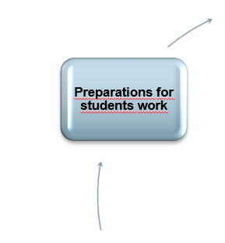
Preparations for student work
Set the rules of “the game”:
Time and frequency of meetings
Student’s study/work plan and timetable
Communication
Need for ethical approval
This Photo by Unknown Author is licensed under CC BY

Slide 10
The student and I have agreed on regular individual or group meetings and we are following the schedule.
The student and I have agreed to respect each other’s working hours and avoid contacting each other on weekends and during vacation time.
I have set up a suitable work schedule with the student and we have agreed on the timeline that he/she will follow.
I am here to support my students and they know that I will do my best to help them; they also know how and when to reach me.
Before data collection began, I checked whether my student’s research needs ethical approval and helped her/him with the procedure.

Slide 11
Formulating research questions and study design
Formulating research questions, study design, and methodology
Preparations for student work
Research process and monitoring
Be actively involved in the whole thesis preparation process, from the beginning to the end.
Guide your student in formulating the research questions, study design, and methodology.
Advise students to keep a research diary as a useful way to save all important information in one place.
ACADEMIC AND
RESEARCH
INTEGRITY
Final considerations
Data processing, analysis, and storage
Academic writting and ethical publishing

Slide 12
The student and I have discussed literature searches and how to find relevant research literature.
The student and I have discussed what type of contribution their thesis will make to existing research in our field.
The student and I have discussed and agreed on research questions, study design, the methodology of the thesis work, and how the research process will be monitored.
The student and I have discussed and agreed on the scope of her/his research and what knowledge and/or skills are needed to implement the research design. If needed, I guided my student using relevant resources, training opportunities, and/or consultation.
If needed, I advised the student to have an additional/external consultant for a planned research topic.

Slide 13
Data processing and analysis
Formulating research questions, study design, and methodology
Check the data management policy and procedures in your institution.
Guide students to prepare a data management plan (DMP).
Preparations for student work
Research process and monitoring
ACADEMIC AND
RESEARCH
INTEGRITY
Final considerations
Data processing, analysis, and storage
Academic writting and ethical publishing

Slide 14
The student and I have agreed on the methods of data processing and analysis that she/he will be using.
I have talked with my student about factors that might influence objectivity in data analysis, such as various forms of bias or conflicts of interest.
I have instructed the student that all potential limitations, biases, and conflicts of interest must be clearly declared in her/his work.
The student and I have discussed the requirements for properly storing research data and have agreed on how and where the thesis data will be stored.
I have talked to my student about the possibility of outliers and about why and how they should not be omitted from the dataset.
I have talked to my student about the importance of anonymizing the research participants (if relevant).

Slide 15
Collaborative work
Formulating research questions , study design, and methodology
If the student’s work is part of a larger research project, discuss with your student potential ethical challenges that may arise in the collaboration process.
Topics recommended for discussion in the context of academic and research integrity: authorship, contributorship, conflict of interest, intellectual property rights, etc.
Preparations for student work
Research process and monitoring
ACADEMIC AND
RESEARCH
INTEGRITY
Final considerations
Data processing, analysis, and storage
Academic writting and ethical publishing

Slide 16
My supervised students and I have discussed and agreed on the authors’ contributions to the joint article/paper.
If the student’s work is part of a larger research project, we have discussed, agreed on, and formalised the relationship between the project and the student’s work in terms of authorship.
If the student’s work is part of a larger research project, we have discussed, agreed on, and formalised the relationship between the project and the student’s work in terms of data use.
If the student’s work is part of a larger research project, we have discussed, agreed on, and formalised the relationship between the project and the student’s work in terms of intellectual property rights.

Slide 17
Supervisor’s role in guiding students in academic writing and ethical publishing
Formulating research questions, study design, and methodology
Make sure your student has sufficient knowledge of academic writing.
If you see that your student has gaps in academic writing ability, help him/her to address them.
Have a conversation with your student about ethical publishing. Discuss topics such as authorship and contributorship, and help your student identify predatory journals.
Preparations for student work
Research process and monitoring
ACADEMIC AND
RESEARCH
INTEGRITY
Final considerations
Data processing, analysis, and storage
Academic writting and ethical publishing

Slide 18
I have directed the student to examples of good academic writing in my discipline.
I have encouraged the student to read appropriate literature on academic writing.
I have regularly reviewed the thesis and made sure that the student is aware of how to cite properly.
I have talked to my student about the importance of using one reference style consistently.
I have advised my student to properly use reference management software.
I made my student aware that he/she must check that all materials (e.g., images, charts, and tables) are appropriately indicated, referenced, and acknowledged before submitting the thesis.
I made the student aware that he/she must check the reference list and whether it is consistent with the references in the text (in-text citations or footnotes).

Slide 19
The student and I have checked the potential publisher’s requirements.
Make sure that the student is aware that the authorship order should reflect individuals’ respective contributions.
The student and I have talked about the importance of only listing as authors all those who have made relevant contributions to the work, as defined by the International Committee of Medical Journal Editors (ICMJE) and the Committee on Publication Ethics (COPE).
The student and I have checked the quality of the journal and I have discussed predatory publishers with my student. In the case of doctoral students, I have explained that work published in such venues cannot be used as part of their thesis.
Make sure that the student is aware of the need to disclose conflicts of interest, if any, and to openly declare them in the publication.
Make sure that the student is aware that contributors who do not qualify as authors should be properly acknowledged.

Slide 20
The importance
of communication
and feedback
Regular consultations
Respectful communication
Constructive feedback
Motivation
Stay in constant contact with your student.
Raising awareness
Regular check-ins
Appreciation of positive aspects

Slide 21
General tips when communicating with students
Enculturate your students in your discipline and help them cross the bridge from being a student to researching.
Encourage your students to interact with the research community and participate in academic events.
Encourage your students to self-reflect and help them develop critical thinking.
Try to motivate your students, and ask them about their work and how it is going.
Show students that you are active and engaged in their thesis and publication work.
If a problem arises, try to solve it for the benefit of the student, without coercion.
Give regular feedback to your students.

Slide 22
I have regular consultations with my students and I follow their ongoing research.
I am always clear and respectful in my communication.
I always try to give constructive feedback and appreciate positive aspects.
I have checked/reviewed whether my supervised student’s data have been collected, recorded, and managed properly.

Slide 23
Final considerations
Formulating research questions, study design, and methodology
Check the institutional requirements for the thesis submission and/or defence.
Check the submitted thesis using text-matching software to identify possible plagiarism and assess the text matches indicated.
Carefully read and analyse all the chapters of the thesis of the candidate before the final defence.
Preparations for student work
Research process and monitoring
ACADEMIC AND
RESEARCH
INTEGRITY
Final considerations
Data processing, analysis, and storage
Academic writting and ethical publishing

Slide 24
What tools and materials can be used when supervising your student or student group?
This Photo by Unknown Author is licensed under CC BY-NC-ND

Slide 25
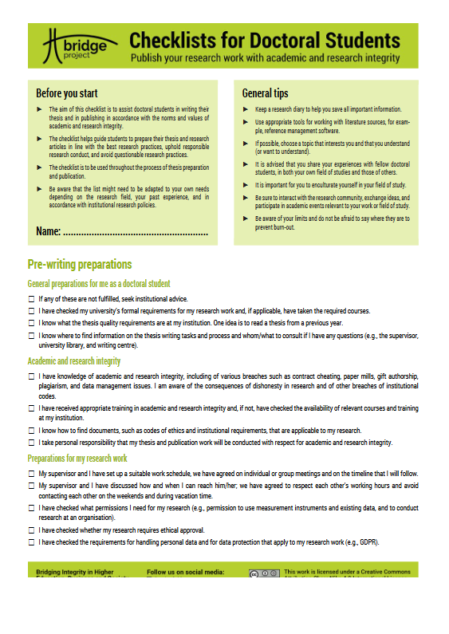
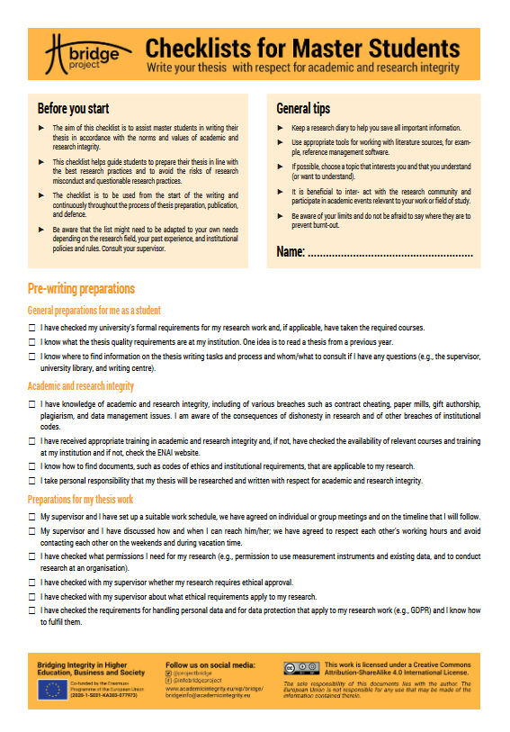
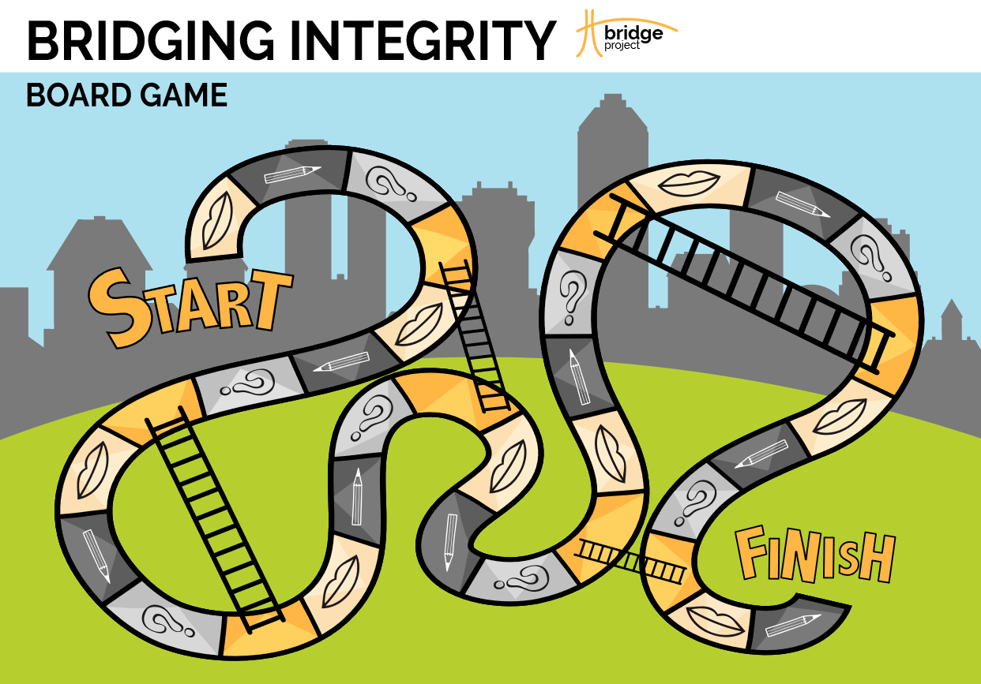
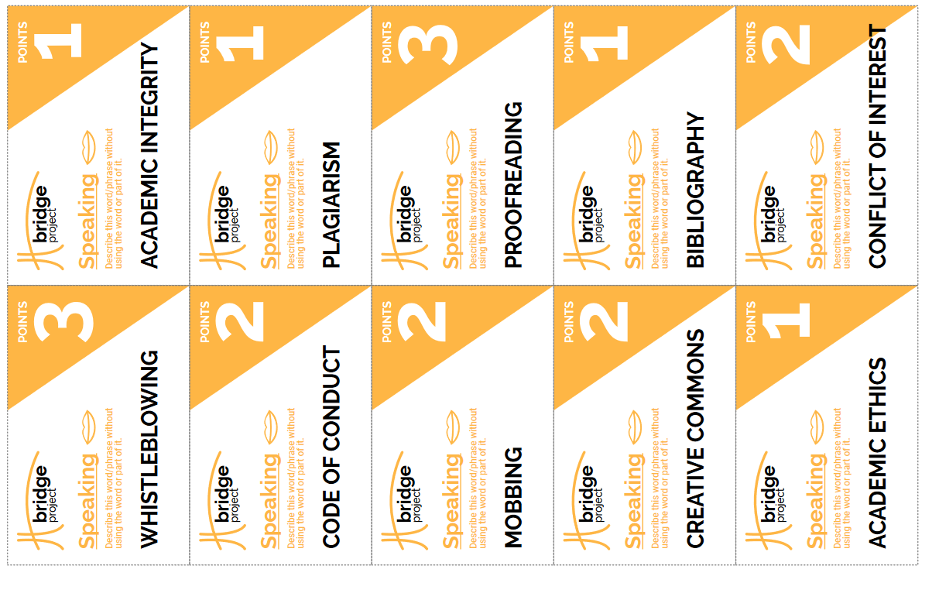
To assist students in writing their thesis and in publishing in accordance with the norms and values of academic and research integrity
To learn about academic and research integrity concepts:
Board game “Bridging integrity” (printed; available at: www.academicintegrity.eu/wp/bridge-games)
Checklists on academic integrity for doctoral and Master’s students (printed or online; available at: www.academicintegrity.eu/wp/bridge-checklists)

Slide 26
For more extensive training:
Module: From academic integrity to research ethics
Module: Authorship module
Module: Data ethics

Slide 27
Thank you!

