Slide 1
MODULE FOR SUPERVISORS
Session 3: Helping students recognize and avoid breaches of academic and research integrity
Created by Sandra Krutulienė (Lithuanian Centre for Social Sciences)

Slide 2
Module for Supervisors Training plan-schedule by sessions
Session 1:
Ethical challenges related to supervision and mentorship in academia
Session 2:
How to help your students write and publish with academic and research integrity (checklists)
Session 3:
Helping students recognize and avoid breaches of academic and research integrity
Session 4:
Supervisor's role in guiding students engaged in citizen science and business-related projects

Slide 3
Supervisor`s role and responsibility
As a supervisor, you have a responsibility to help students avoid ethical breaches and questionnable research practices
You should have a conversation with the student or group of students about ethical breaches
As a supervisor, you have a responsibility to explain to your student the consequences of dishonesty in research (e.g., plagiarism, data fabrication, and other violations of academic ethics and procedures)
You can use gamified educational materials when talking to students about ethical breaches and misconduct

Slide 4
How to help students understand, recognise, and avoid ethical misconduct?
Read relevant literature
Theorethical lectures
Discussions
Practical experience
Games and real-life cases
Other ways: you name it!

Slide 5
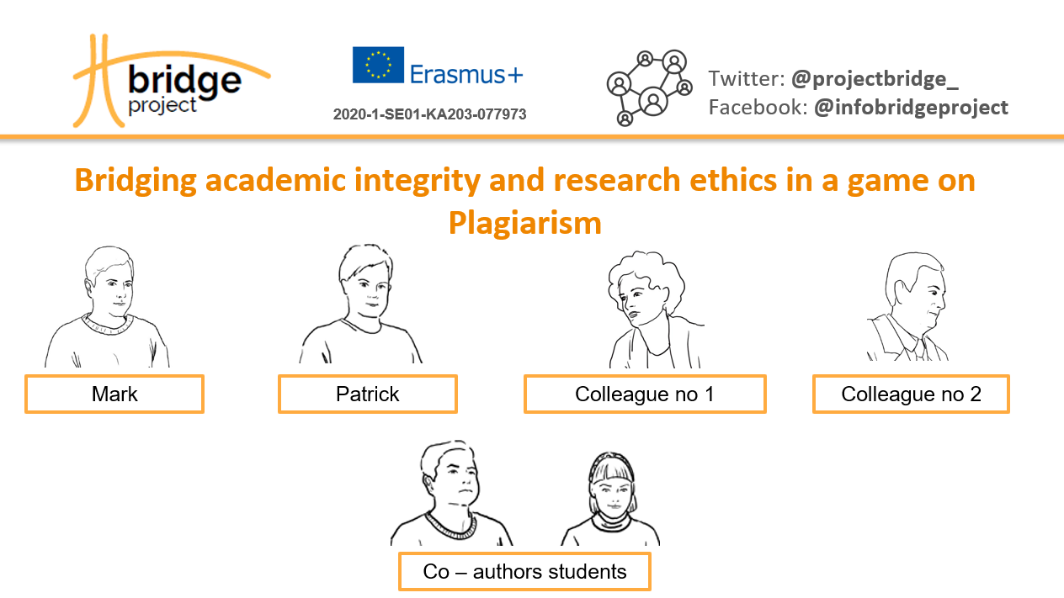
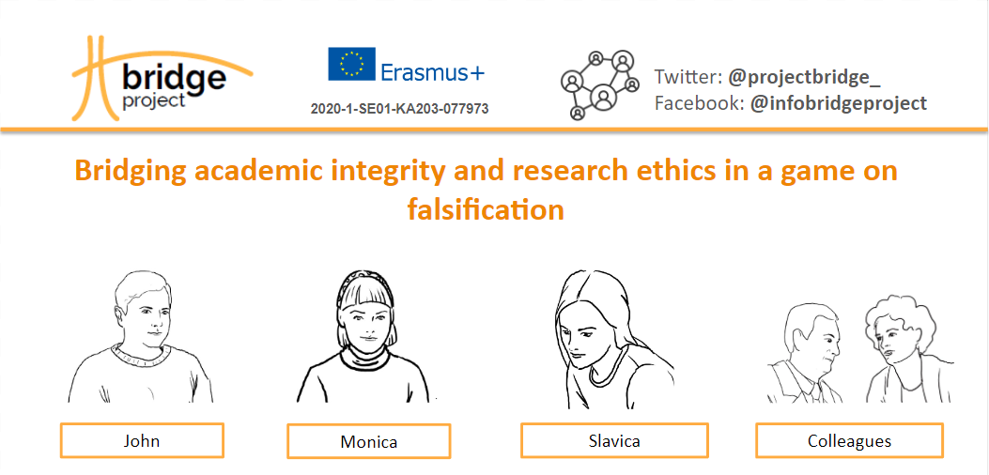
Gamified cases for raising awareness of misconduct in research and its consequences

Slide 6
You have now an opportunity to test some gamified educational material!
Let’s play a game!
To collect information from a larger number of players, you can use www.menti.com

Slide 7
What tools and materials can be used when supervising your student or students’ group?
Dilemmas in the form of multiple-choice storytelling games
Educational modules
Game: Bridging Academic and Research Integrity in a Game on Fabrication and Note for Educators.
Game: Bridging Academic and Research Integrity in a Game on Falsification and Note for Educators.
Game: Bridging Academic and Research Integrity in a Game on Plagiarism and Note for Educators.
Module: Academic integrity and research ethics
Module: Authorship module
Module: Data ethics

Slide 8
Thank you!

