Slide 1
Integrity in research and business collaboration Conflict of interest scenario

Slide 2
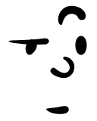
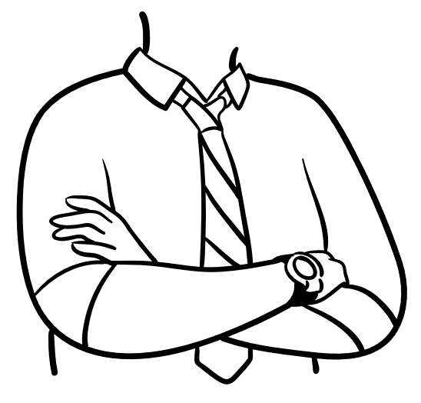
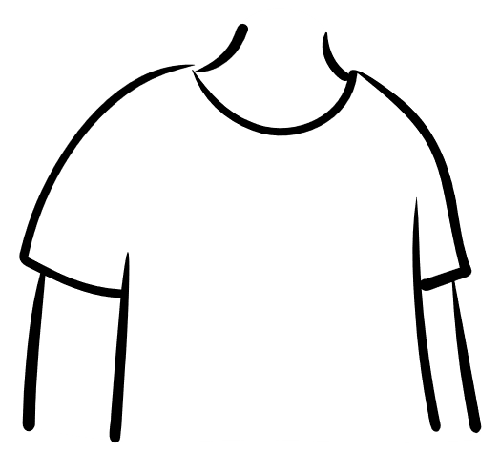
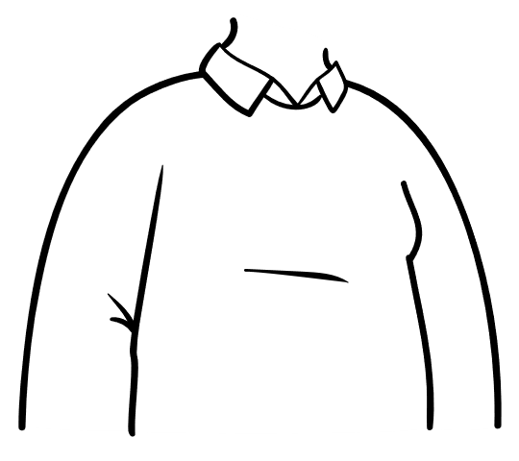
Integrity in research and business collaboration Conflict of interest scenario
The manager at a pharmaceutical company
George, the director of a research institute and a research group leader
Erika, a young researcher at the institute
Tim, senior researcher at the institute

Slide 3
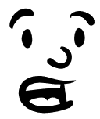
A pharmaceutical company that specializes in respiratory disorders wants to develop innovative treatments for patients. The company manager approaches George, the director of a research institute and a research group leader who has experience leading similar research, and proposes to collaborate on this topic. The research team will identify potential treatment candidates and researchers from both the research institute and the company will participate.
...

Slide 4
George is excited to negotiate since he expects to be able to publish his findings and the earnings will be lucrative. The company has agreed to provide the essential technological and laboratory equipment for the research as well as staff to perform some of the measurements and maintain the research facilities.

Slide 5
George invites one of the institute’s researchers, Tim, to join this project. Tim is even more eager to participate in the promising research project because he also owns shares in the company that proposed the project.
...

Slide 6
A. Should Tim inform George about his relationship with the company?
A1. Tim informs George about his relationship with the company.
A2. Tim decides not to disclose his ties with the company.

Slide 7
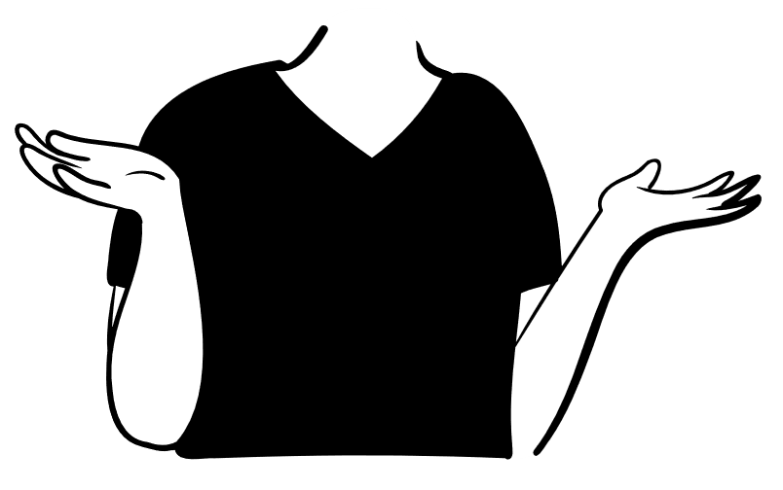
A1. Tim informs George about his relationship with the company. What should George do?
A1.1. George decides that Tim cannot join the collaborative research.
A1.2. George does not find this to be an issue and suggests Tim not to bring this matter to the attention of his colleagues.
A1.3. George suggests that Tim should declare his relationship with the company.
...

Slide 8
A1.1. George decides that Tim cannot join the collaborative research.
A1.1.1. Tim does not join the collaborative research.

Slide 9
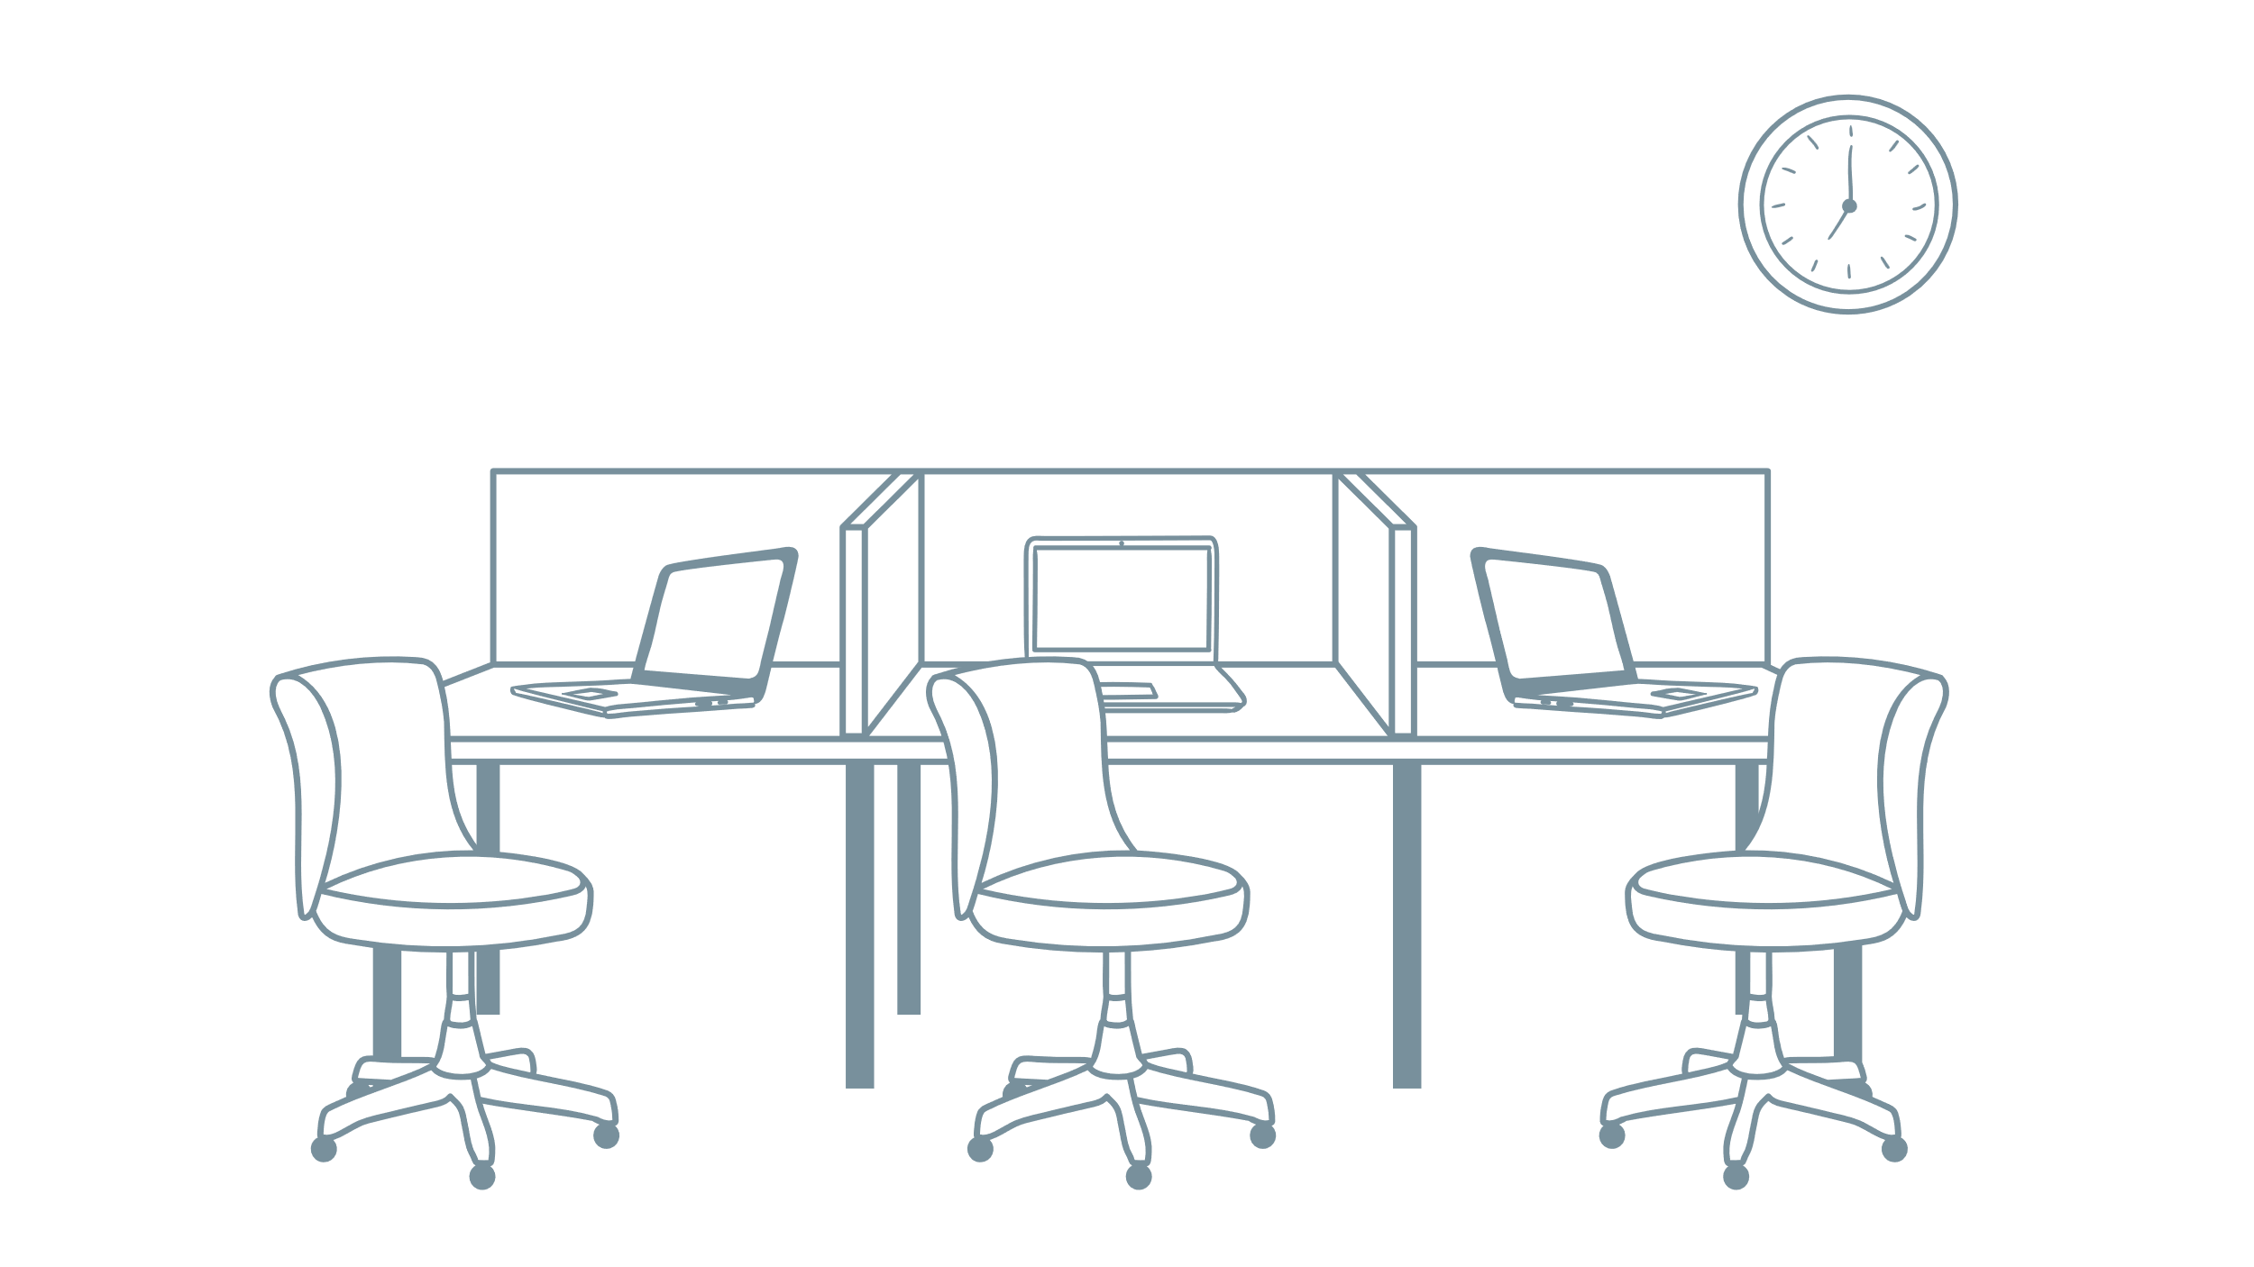
A1.2. George does not find this to be an issue and suggests Tim not to bring this matter to the attention of his colleagues.
A1.2.1. Tim joins the collaborative research, without mentioning his relationship with company to anyone.

Slide 10
A1.3. George suggests that Tim should declare his relationship with the company.
A1.3.1. Tim joins the collaborative research. He discloses his relationship with the company by filling a conflict of interest declaration form.

Slide 11
A2. Tim decides not to disclose his ties with the company.
A2.1. Tim joins the collaborative research. He does not mention his relationship with the company to anyone.

Slide 12
Tim tells his colleague Erika, a freelancer who has recently completed her PhD in the area, about the collaborative research. Since Erika is interested in the project, Tim tells her that he will recommend her to George.
Erika joins the project on George’s invitation. She has little experience in conducting collaborative research; nevertheless, she expects that it will contribute to her academic career, as publishing the research results could lead to a full-time position at the institute.

Slide 13
The collaborative research agreement is drafted. The company manager insists that the measurement data will be solely managed by its staff. They will manage the access rights to research data.
All researchers shall also sign confidentiality (non-disclosure) agreements in which participating researchers are forbidden from disclosing the research results without the company’s consent.
...

Slide 14
B1. Should George sign the collaborative research agreement?
B1.1. George signs the collaborative research agreement without further delay since it is a standard template and further discussion will delay the research.
B1.2. George discusses the conditions of the collaborative research agreement with the research team and company’s researchers.

Slide 15
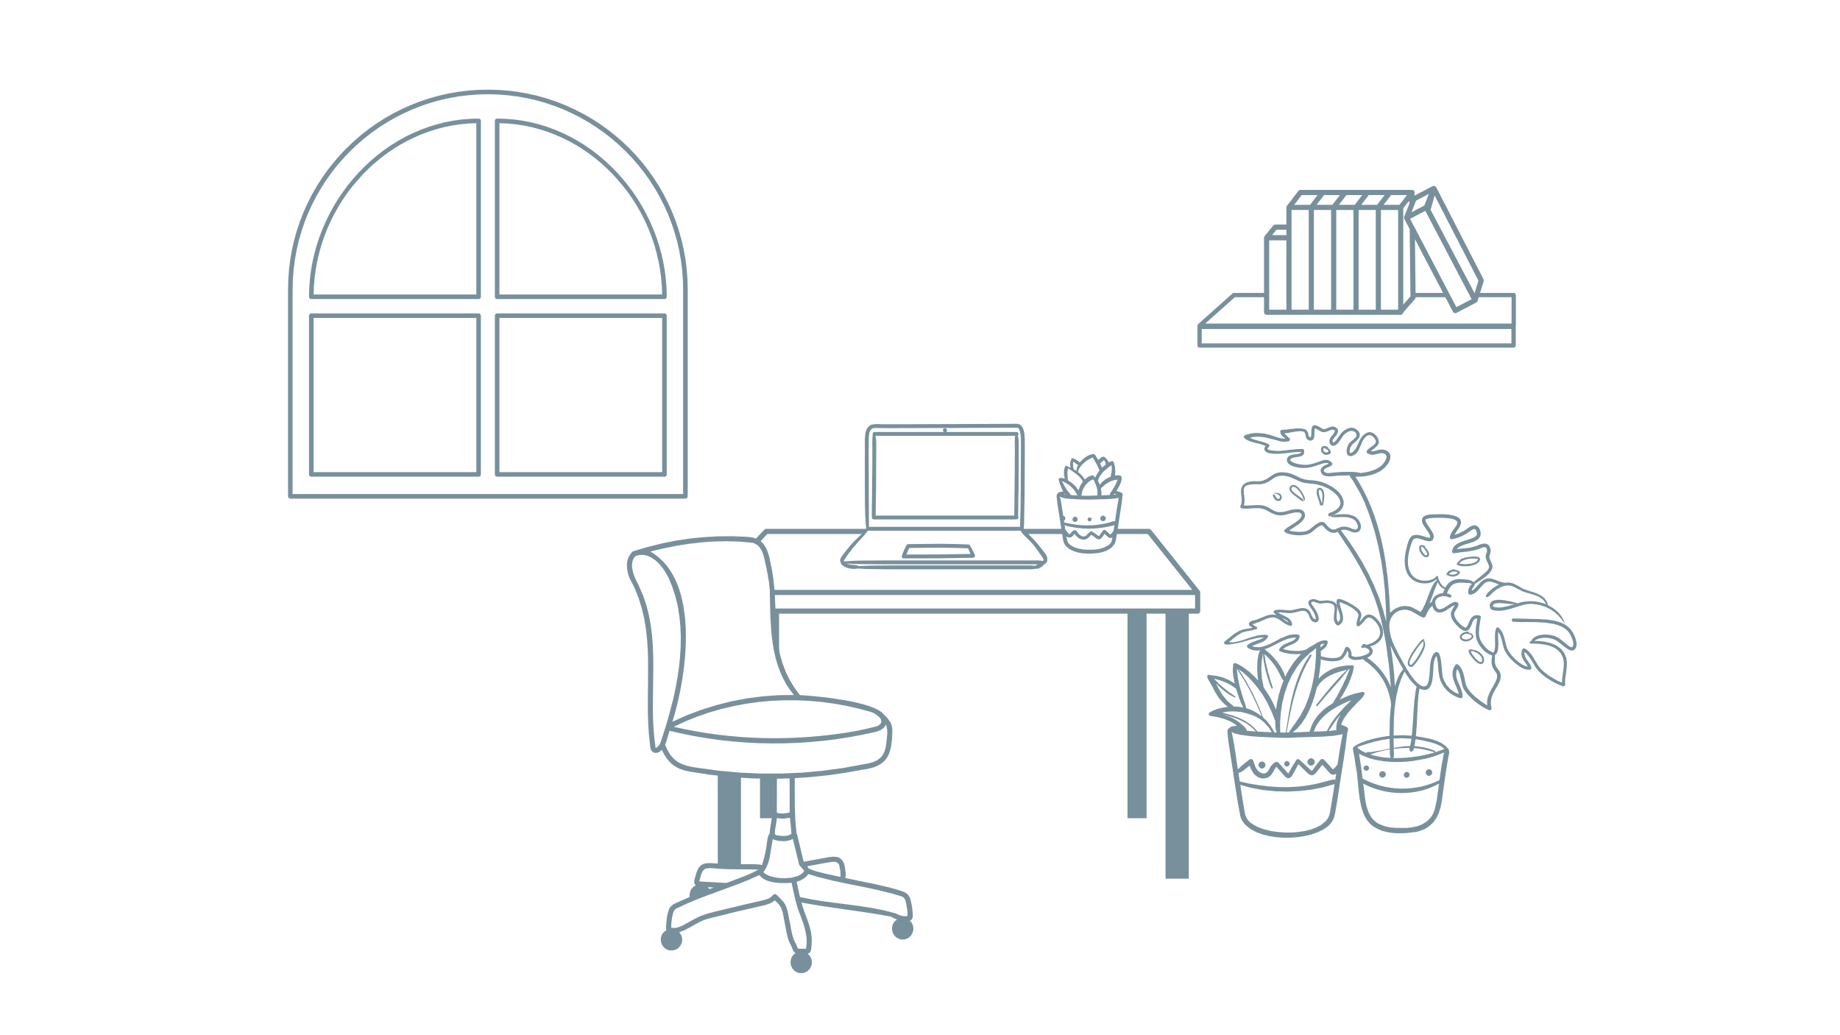
B1.1. George signs the collaborative research agreement without further delay since it is a standard template and further discussion will delay the research.
B1.1.1. The agreement is signed and the research is conducted.

Slide 16
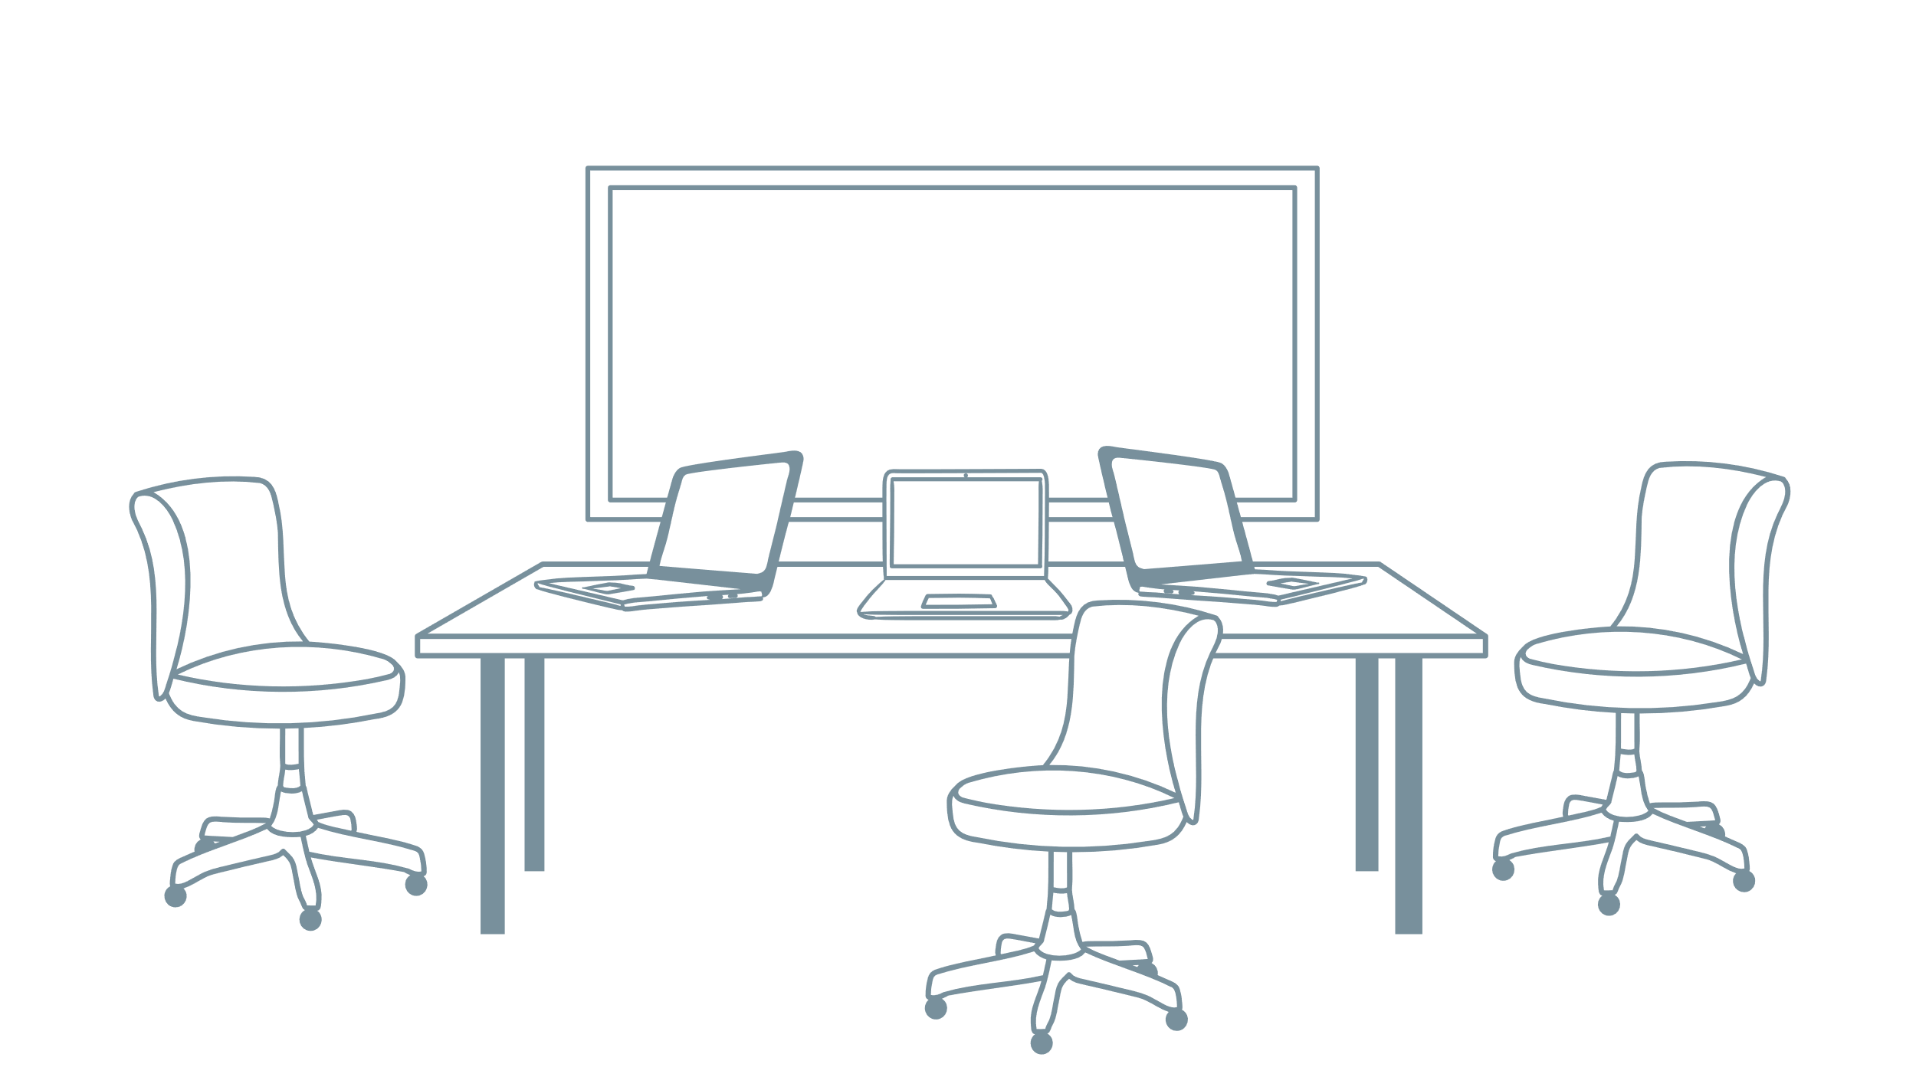
B1.2. George discusses the conditions of the collaborative research agreement with the research team and company‘s researchers.
B1.2.1. The research team discusses the aims of the research, defines the essential terms of ethical research, and discusses the procedures of dealing with breaches of good research practice from both sides. The researchers agree to draft data management plan where, among other things, all aspects of data access are discussed in detail. The template of declaration of conflict of interest is developed and all co-researchers are asked to declare their possible and emerging conflict of interest.
The agreement is signed and the research is conducted.

Slide 17
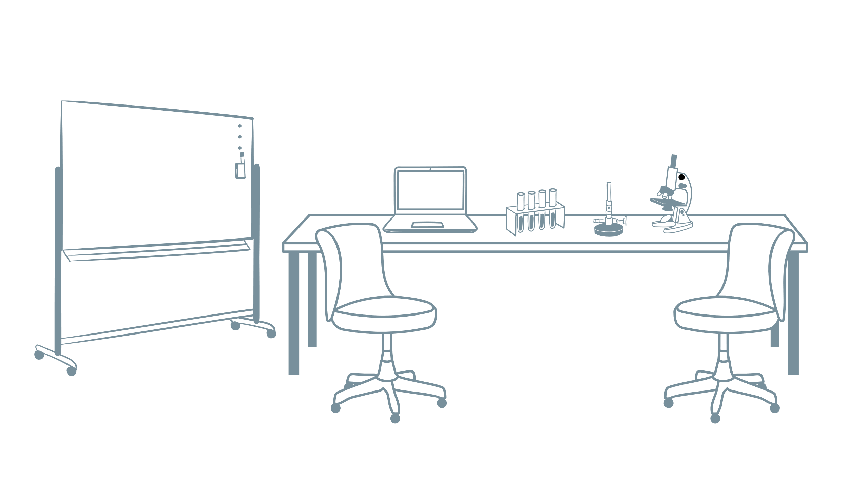
The research demonstrates non-conclusive (both positive and negative) results concerning the effects of the treatment on study participants.
Erika is worried about the contradictory results and asks to inspect the data and repeat the data analysis. However, the company’s researchers do not provide the full data set and insist on including only positive results in a publication and omitting the negative ones. In fact, they suggest that only they may draft certain portions of the manuscript. However, they prefer not to be mentioned as co-authors of the publication.

Slide 18
Erika consults with George and Tim about whether they should co-author the manuscript as it stands now.
Tim insists on suppressing some of the results and argues that negative results may diminish the value of the findings. He insists that Erika is making it into a bigger problem than it is and that the company’s researchers are skilled in collecting, analysing and interpreting this type of data.
George supports Tim and points out that the company has the right to restrict publishing.

Slide 19
C. Should Erika agree on co-authoring a manuscript?
C1. Erika decides not to co-author the manuscript and withdraws from the collaboration.
C2. Erika is worried that negative results may diminish the value of the findings and agrees to co-author the manuscript.
C3. Erika is afraid that further arguing with George will diminish her career prospects; so she agrees to co-author the manuscript.
C4. Erika agrees to co-author the manuscript and suggests publishing all results though they may reduce the potential for the treatment to be adopted.

Slide 20
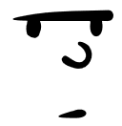
C1. Erika decides not to co-author the manuscript and withdraws from the collaboration.
C1.1. The manuscript is published, including only positive results and omitting the negative results.
In a few years, several other research groups publish the results that do not support the findings of George’s research team. Moreover, during this time, it is revealed that one of the leading researchers, Tim, did not disclose his relationship with the company that had sponsored the research. The editor-in-chief of the journal expresses concern about the quality of their work, given the potential for conflict of interest.

Slide 21
C2. Erika is worried that negative results may diminish the value of the findings and agrees to co-author the manuscript.
C3. Erika is afraid that further arguing with George will diminish her career prospects; so she agrees to co-author the manuscript.
C2.1. / C3.1. Erika co-authors the manuscript that includes only positive results but omits the negative ones. The manuscript is published.
In a few years, several other research groups publish the results that do not support the findings of George’s research team. Moreover, during this time, it is revealed that one of the leading researchers, Tim, did not disclose his relationship with the company that had sponsored the research. The editor-in-chief of the journal expresses concern about the quality of their work. Since Erika had not indicated in detail the contribution of co-researchers in the manuscript, they are all held responsible for the biased results.

Slide 22
C4. Erika agrees to co-author a manuscript and suggests publishing all results though they may reduce the potential for the treatment to be adopted.
C4.1. Erika co-authors the manuscript that discusses all the results obtained in the research. However, the company manager opposes submission of the manuscript since the research results do not indicate an unambiguously positive effect of the treatment. He warns her and other researchers that they will be sued if they disclose research results without the company’s consent. The researchers decide not to publish the manuscript.

Slide 23
The research demonstrates non-conclusive (both positive and negative) results concerning the effects of the treatment on study participants.
Erika is worried about the contradictory results and asks to inspect the data and repeat the data analysis.

Slide 24
After obtaining the negative results Erika consults George and Tim to discuss whether they should co-author the manuscript as it stands now.
Tim insists on suppressing some of the results and argues that negative results may diminish the value of the findings. He insists that Erika is making it into a bigger problem than it is and that the company’s researchers are skilled in collecting, analysing and interpreting this type of data.
George supports Tim; however, he points out that the company has no right to restrict publishing.

Slide 25
Erika co-authors the manuscript that includes all the results obtained in the research though they do not indicate an unambiguously positive effect of the treatment. The researchers publish all the results, including the negative ones.
In a few years, several other research groups publish the results that support the findings of George’s research team. However, during this time, it is revealed that one of the leading researchers, Tim, did not disclose his relationship with the company that had sponsored the research. The editor-in-chief of the journal expresses concern about the quality of their work.

Slide 26
Tim tells his colleague Erika, a freelancer who has recently completed her PhD in the area, about the collaborative research. Since Erika is interested in the project, Tim tells her that he will recommend her to George.
Erika joins the project on George’s invitation. She has little experience in conducting collaborative research; nevertheless, she expects that it will contribute to her academic career, as publishing the research results could lead to a full-time position at the institute.

Slide 27
The collaborative research agreement is drafted. The company manager insists that the measurement data will be solely managed by its staff. They will manage the access rights to research data.
All researchers shall also sign confidentiality (non-disclosure) agreements in which participating researchers are forbidden from disclosing the research results without the company’s consent.
...

Slide 28
B1. Should George sign the collaborative research agreement?
B1.1. George signs the collaborative research agreement without further delay since it is a standard template and further discussion will delay the research.
B1.2. George discusses the conditions of the collaborative research agreement with the research team and company’s researchers.

Slide 29
B1.1. George signs the collaborative research agreement without further delay since it is a standard template and further discussion will delay the research.
B1.1.1. The agreement is signed and the research is conducted.

Slide 30
B1.2. George discusses the conditions of the collaborative research agreement with the research team and company‘s researchers.
B1.2.1. The research team discusses the aims of the research, defines the essential terms of ethical research, and discusses the procedures of dealing with breaches of good research practice from both sides. The researchers agree to draft data management plan where, among other things, all aspects of data access are discussed in detail. The template of declaration of conflict of interest is developed and all co-researchers are asked to declare their possible and emerging conflict of interest.
The agreement is signed and the research is conducted.

Slide 31
The research demonstrates non-conclusive (both positive and negative) results concerning the effects of the treatment on study participants.
Erika is worried about the contradictory results and asks to inspect the data and repeat the data analysis. However, the company’s researchers do not provide the full data set and insist on including only positive results in a publication and omitting the negative ones. In fact, they suggest that only they may draft certain portions of the manuscript. However, they prefer not to be mentioned as co-authors of the publication.

Slide 32
Erika consults with George and Tim about whether they should co-author the manuscript as it stands now.
Tim insists on suppressing some of the results and argues that negative results may diminish the value of the findings. He insists that Erika is making it into a bigger problem than it is and that the company’s researchers are skilled in collecting, analysing and interpreting this type of data.
George does not support Tim since he is aware of Tim’s relationship with the company; however, he points out that the company has the right to restrict publishing.

Slide 33
C. Should Erika agree on co-authoring a manuscript?
C1. Erika decides not to co-author the manuscript and withdraws from the collaboration.
C2. Erika is worried that negative results may diminish the value of the findings and agrees to co-author the manuscript.
C3. Erika is afraid that further arguing with George will diminish her career prospects; so she agrees to co-author the manuscript.
C4. Erika agrees to co-author the manuscript and suggests publishing all results though they may reduce the potential for the treatment to be adopted.

Slide 34
C1. Erika decides not to co-author the manuscript and withdraws from the collaboration.
C1.1. The manuscript is published, including only positive results and omitting the negative results.
In a few years, several other research groups publish the results that do not support the findings of George’s research team. The editor-in-chief of the journal expresses concern about the quality of their work.

Slide 35
C2. Erika is worried that negative results may diminish the value of the findings and agrees to co-author the manuscript.
C3. Erika is afraid that further arguing with George will diminish her career prospects; so she agrees to co-author the manuscript.
C2.1. / C3.1. Erika co-authors the manuscript that includes only positive results but omits the negative ones. The manuscript is published.
In a few years, several other research groups publish the results that do not support the findings of George’s research team. The editor-in-chief of the journal expresses concern about the quality of their work. Since Erika had not indicated in detail the contribution of co-researchers in the manuscript, they are all held responsible for the biased results.

Slide 36
C4. Erika agrees to co-author a manuscript and suggests publishing all results though they may reduce the potential for the treatment to be adopted.
C4.1. Erika co-authors the manuscript that discusses all the results obtained in the research. However, the company manager opposes submission of the manuscript since the research results do not indicate an unambiguously positive effect of the treatment. He warns her and other researchers that they will be sued if they disclose research results without the company’s consent. The researchers decide not to publish the manuscript.

Slide 37
The research demonstrates non-conclusive (both positive and negative) results concerning the effects of the treatment on study participants.
Erika is worried about the contradictory results and asks to inspect the data and repeat the data analysis.

Slide 38
After obtaining the negative results Erika consults George and Tim to discuss whether they should co-author the manuscript as it stands now.
Tim insists on suppressing some of the results and argues that negative results may diminish the value of the findings. He insists that Erika is making it into a bigger problem than it is and that the company’s researchers are skilled in collecting, analysing and interpreting this type of data.
George does not support Tim since he is aware of Tim’s relationship with the company. He also points out that the company has no right to restrict publishing.

Slide 39
Erika co-authors the manuscript that includes all the results obtained in the research though they do not indicate an unambiguously positive effect of the treatment. The researchers publish all the results, including the negative ones.
In a few years, several other research groups publish the results that support the findings of George’s research team.

Slide 40
Focus questions:
1. Why is it important to disclose potential and emerging conflict of interest?
2. How should conflict of interest be mitigated?
3. What are the implications of failure to disclose potential and emerging conflict of interest? Consider the implications on research credibility, researcher‘s career, reputation, patient safety.
4. What are the means to mitigate bias in a collaborative research?
5. What issues should be discussed in a collaborative research agreement?

Slide 41
Feedback
Conflict of interest occurs when a researcher, who should seek for professional, objective scientific judgement at any stage of research (i.e. “primary interest”), has at the same time some other interest(s), e.g. financial, professional, personal (i.e. “secondary interest”) (ICMJE, 2022, p. 3; IOM, 2009, p. 6; Smith, 2006, p. 292). Conflict of interest is a situation when secondary interests might „compromise judgement or objectivity“ of the research (Tauginienė et al., 2018, p. 14). Conflicts of interest could be rather widespread (Smith, 2006). However, having such interests is not necessarily considered as unethical (Roig, 2015), but rather as a circumstance that might, consciously or not, lead to unethical behaviour and bias (Smith, 2006). It is important to note that the researchers do not necessarily intentionally compromise the research for their personal gain; often bias is unintentional and/or unconscious (Cain & Detsky, 2008; Smith, 2006). Financial conflicts of interests are rather easy to detect and report (ICJME, 2022; The PLoS Medicine Editors, 2008), while others are arguably less obvious (for discussion on perception and management of non-financial conflicts of interest see e.g. Bero & Grundy, 2016; Wiersma et al., 2018). Notably, non-financial competing interests (such as career advancement, academic recognition) may lead to as much devastating effect on research integrity as financial ones (such as stock ownership) (see e.g. The PLoS Medicine Editors, 2008).
Though often conflicts of interest cannot be avoided, it is important to manage them properly. Handling of conflicts of interest is primarily done via the disclosure (COPE Council, 2016; ICJME, 2022; The PLoS Medicine Editors, 2008). Since each scientific publisher usually has its own policy on managing conflicts of interest, it is advisable that the researchers should consult disclosure forms of relevant publishers (for generic example, see ICMJE disclosure form). Other means may be also employed, such as self-reflection exercise for researchers, consulting institutional policy on managing conflicts of interest if available etc. (Bero & Grundy, 2016). Finally, if the research poses too high risk for bias or damage and other means are not effective, withdrawal from or not entering the research should be considered (see e.g. Smith, 2006; Bero & Grundy, 2016).

Slide 42
Poor management of conflicts of interest may have consequences, such as diminished integrity of the research, risk of bias, exposure of research participants to unnecessary risks in clinical trials and of patients to ineffective and unsafe treatment, erosion of public trust in research, and damaged institutional and individual reputations (IOM, 2009). Failure to disclose conflicts of interest may threaten condition of research subjects and public trust in research (for example, for the case of Gelsinger see e.g. Shamoo & Resnik, 2022).
Failure to manage financial and other conflicts of interest may lead to bias or other unethical behaviour (Smith, 2006; Steneck, 2006). Bias is attributed to questionable research practices; however, its significance cannot be underestimated since it is more widespread than FFP (fabrication, falsification, plagiarism) and may have more financial and health implications (Steneck, 2006). Bias in research arising from financial and other interests promoting false positive results contributes to the lack of reproducibility of research (Baker et al., 2020; Munafò et al., 2017).
Although difficult to detect, bias is potentially an issue in the collaborative research with industry (Shamoo and Resnik, 2022). Correlation between funding sources and research outcomes has been observed in various industry-sponsored research projects, such as drug safety and efficacy studies, tobacco research, and chemical toxicity studies (see e.g. Krimsky, 2013; Lundh et al., 2017). This may indicate bias in some cases, although other explanations also may be considered (Krimsky, 2013).
Moreover, the researchers are often limited by confidentiality agreements. To promote their interests, the industrial partners often require researchers to enter into the agreements, which restrict access to the data or publishing of research results (Shamoo and Resnik, 2022). The researcher should consider in advance if such legally binding provisions correspond to their expectations.

Slide 43
References
Baker, L., Cristea, I. A., Errington, T. M., Jaśko, K., Lusoli, W., MacCallum, C. J., Parry, V., Pérignon, C., Šimko, T., & Winchester, C. (2020). Reproducibility of scientific results in the EU. Scoping report. European Commission. https://data.europa.eu/doi/10.2777/341654.
Bero, L. A., & Grundy, Q. (2016). Why Having a (Nonfinancial) Interest Is Not a Conflict of Interest. PLoS Biology, 14(12), e2001221. https://doi.org/10.1371/journal.pbio.2001221.
Cain, D. M., & Detsky, A. S. (2008). Everyone’s a Little Bit Biased (Even Physicians). JAMA, 299 (24), 2893–2895. https://doi.org/10.1001/jama.299.24.2893.
COPE Council (2016). COPE Discussion Document: Handling competing interests. https://doi.org/10.24318/ElTeSLhp.
ICMJE [International Committee of Medical Journal Editors] (2022). Recommendations for the conduct, reporting, editing, and publication of scholarly work in medical journals. Accessed 4 August 2022 at http://www.icmje.org/recommendations/.
ICMJE [International Committee of Medical Journal Editors] (n.d.). Disclosure form. https://www.icmje.org/recommendations/browse/roles-and-responsibilities/author-responsibilities--conflicts-of-interest.html.
IOM [Institute of Medicine] (2009). Conflict of Interest in Medical Research, Education, and Practice. The National Academies Press. https://doi.org/10.17226/12598.
Krimsky, S. (2013). Do Financial Conflicts of Interest Bias Research?: An Inquiry into the “Funding Effect” Hypothesis. Science, Technology, & Human Values, 38(4), 566–587. https://doi.org/10.1177/0162243912456271.
Lundh, A., Lexchin, J., Mintzes, B., Schroll, J. B., & Bero, L. (2017). Industry sponsorship and research outcome. Cochrane Database of Systematic Reviews, 2, MR000033. https://doi.org/10.1002/14651858.MR000033.pub3.
Munafò, M. R., Nosek, B. A., Bishop, D. V. M., Button, K. S., Chambers, C. D., Percie du Sert, N., Simonsohn, U., Wagenmakers, E.-J., Ware, J. J., & Ioannidis, J. P. A. (2017). A manifesto for reproducible science. Nature Human Behaviour, 1, 0021. https://doi.org/10.1038/s41562-016-0021.

Slide 44
Roig, M. (2015). Avoiding plagiarism, self-plagiarism, and other questionable writing practices: A guide to ethical writing. Office of Research Integrity. https://ori.hhs.gov/avoiding-plagiarism-self-plagiarism-and-other-questionable-writing-practices-guide-ethical-writing.
Shamoo, A. E., & Resnik, D. B. (2022). Responsible Conduct of Research (4th ed.). Oxford University Press.
Smith, R. (2006). Conflicts of interest: how money clouds objectivity. Journal of the Royal Society of Medicine, 99(6), 292–297. https://doi.org/10.1177/014107680609900615.
Steneck, N. H. (2006). Fostering integrity in research: definitions, current knowledge, and future directions. Science and Engineering Ethics, 12(1), 53–74. https://doi.org/10.1007/pl00022268.
Tauginienė, L., Gaižauskaitė, I., Glendinning, I., Kravjar, J., Ojsteršek, M., Ribeiro, L., Odiņeca, T., Marino, F., Cosentino, M., Sivasubramaniam, S. & Foltýnek, T. (2018). Glossary for Academic Integrity. ENAI Report 3G [online].
The PLoS Medicine Editors (2008). Making Sense of Non-Financial Competing Interests. PloS Medicine, 5(9), e199, 1299–1301. https://doi.org/10.1371/journal.pmed.0050199.
Wiersma, M., Kerridge, I., Lipworth, W., & Rodwin, M. (2018). Should we try to manage non-financial interests? BMJ, 361, k1240. https://doi.org/10.1136/bmj.k1240.
Images used from Microsof 365 Stock Images.

Slide 45
Useful resources for further reading and links
Guidance:
ICMJE [International Committee of Medical Journal Editors] (2022). Recommendations for the conduct, reporting, editing, and publication of scholarly work in medical journals. Accessed 4 August 2022 at http://www.icmje.org/recommendations/.
Mansi, B. A., Clark, J., David, F. S., Gesell, T. M., Glasser, S., Gonzalez, J., Haller, D. G., Laine, C., Miller, C. L., Mooney, L. A., & Zecevic, M. (2012). Ten Recommendations for Closing the Credibility Gap in Reporting Industry-Sponsored Clinical Research: A Joint Journal and Pharmaceutical Industry Perspective. Mayo Clinic Proceedings, 87(5), 424–429. https://doi.org/10.1016/j.mayocp.2012.02.009.
Munafò, M. R., Nosek, B. A., Bishop, D. V. M., Button, K. S., Chambers, C. D., Percie du Sert, N., Simonsohn, U., Wagenmakers, E.-J., Ware, J. J., & Ioannidis, J. P. A. (2017). A manifesto for reproducible science. Nature Human Behaviour, 1, 0021. https://doi.org/10.1038/s41562-016-0021.
The Responsible Partnering Initiative (2009). Joining Forces in a World of Open Innovation: Guidelines for Collaborative Research and Knowledge Transfer between Science and Industry. https://eua.eu/downloads/publications/responsible%20partnering%20joining%20forces%20in%20a%20world%20of%20open%20innovation.pdf.
Templates, forms:
Intellectual Property Office (2022). University and business collaboration agreements: Lambert Toolkit. https://www.gov.uk/guidance/university-and-business-collaboration-agreements-lambert-toolkit.
ICMJE [International Committee of Medical Journal Editors] (n.d.). Disclosure form. https://www.icmje.org/recommendations/browse/roles-and-responsibilities/author-responsibilities--conflicts-of-interest.html.

